Slide 1
L5 Connect
Training Session
September 2022

Slide 2
Training Plan

Slide 3
What We Will Cover
1. How to Get Technical Support
2. Documentation
3. System Overview
4. Administration Client Overview
5. Reports in Detail
6. Alerts and Notifications
7. Setting Up Tool Maintenance Plans
8. Toolbox Overview & Maintenance
9. Toolbox Calibration & Drawer Training
10. Hardware Deep Dive
11.Q & A

Slide 4
L5 Connect
Technical Support Information

Slide 5
How to get Technical Support
For the quickest response, please contact our technical support team.
Phone
1-800-272-2033 ex2
Email
techsuppe@snapon.com
soetechsupport@snapon.com
If you try to contact Engineering for support, our response may be delayed
Available M-F 7am to 5pm CDT

Slide 6
When you contact Tech Support
Completely describe the issue including as many details as possible.
How often does this issue occur? (Once, occasionally, etc...)
Does this issue occur after a specific event or series of events? If so, describe the events.
Include any errors displayed by the ATC software.
Include screen shots that show the error condition.
Include any known approximate date and times that the issue occurred
Completely describe the ATC device
Device serial number (starts with Z)
On which version of ATC software is the issue occurring?
What have you already tried?
If possible, include all log files (device, service, and admin) that cover the time frame of the issue.

Slide 7
L5 Connect
Technical Documentation

Slide 8


Documentation
Administration Guide
  How-to’s and procedures for managing the system
ATC Operations Guide
  In-depth instructions on how to use and maintain the ATC Device
Electronic and Paper copies available

Slide 9
L5 Connect
System Overview

Slide 10
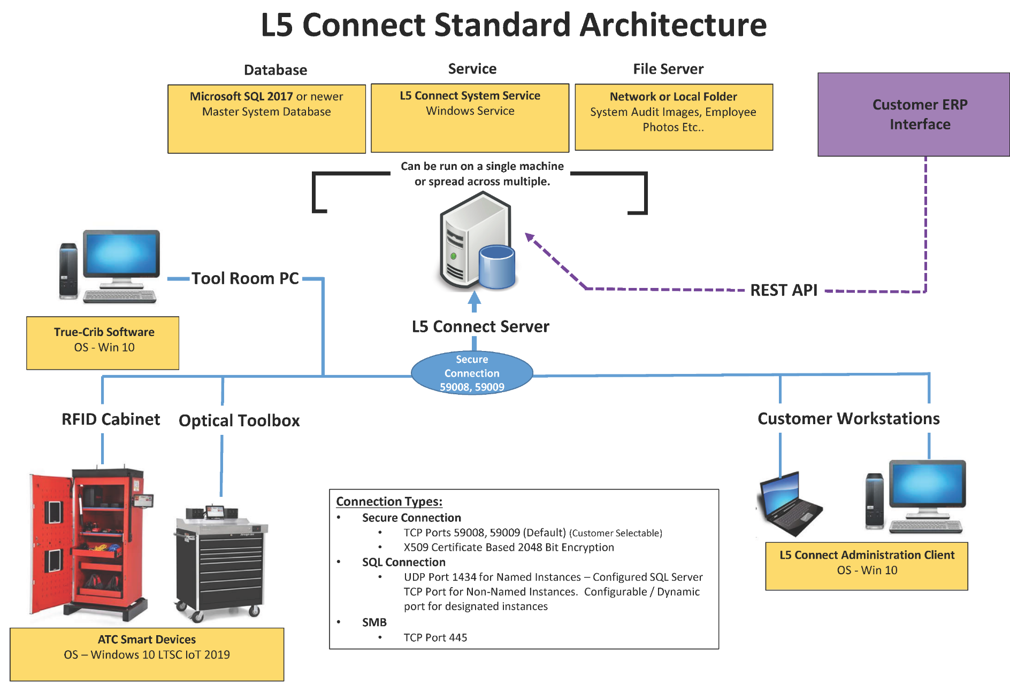

Slide 11
Minimum Requirements – Application / File Server
L5 Connect Service - up to 20 Devices*
CPU | Dual Core @ 2.0GHz
RAM | 2GB DDR4
Storage | 250GB**
OS | Windows 10 1709 & newer or Windows Server 2016 & newer
L5 Connect Service – 21 to 100 Devices*
CPU | Quad Core @ 2.0GHz
RAM | 4GB DDR4
Storage | 1TB**
OS | Windows 10 1709 & newer or Windows Server 2016 & newer
If more than 20 devices are used, it is recommended to install service on a Server.
* Devices include Optical Toolbox, RFID Cabinet, & True-Crib
** Storage based on 5-year usage, 300 MB hard drive space plus additional 150MB per active box per month for service archive
Notes:
TrueSite has a minimal hardware resource requirement and allows it to run on a wide range of different hardware platforms such as budget desktops, mini PCs, and Laptops. Please note, that the Disk Space shown here is for the initial Install only. It will help if you plan your storage solution based on the need for the implementation. A good rule of thumb is: for each device, you plan on connecting to this service, add 150MB of disk space per month that the device is connected. TrueSite requires an active network connection to any device that connects to the service. TrueSite only runs on a modern windows-based platform such as Windows 10 or Server 2012R2 or newer. Finally, the TrueSite Installer and License file are needed to install the software and activate it.

Slide 12
Minimum Requirements – Database Server
L5 Connect Database - up to 100 Devices*
CPU | Quad Core @ 2.0GHz
RAM | 4GB DDR4
Storage | 10GB***
OS | Windows 10 1709 & newer or Windows Server 2016 & newer
SQL | SQL Express 2017 or newer
If more than 100 devices are used, the full version of SQL Server is recommended.
* Devices include Optical Toolbox, RFID Cabinet, & True-Crib
*** SQL Express restricts a database to reach a maximum size of 10GB.
Notes:
TrueSite has a minimal hardware resource requirement and allows it to run on a wide range of different hardware platforms such as budget desktops, mini PCs, and Laptops. Please note, that the Disk Space shown here is for the initial Install only. It will help if you plan your storage solution based on the need for the implementation. A good rule of thumb is: for each device, you plan on connecting to this service, add 150MB of disk space per month that the device is connected. TrueSite requires an active network connection to any device that connects to the service. TrueSite only runs on a modern windows-based platform such as Windows 10 or Server 2012R2 or newer. Finally, the TrueSite Installer and License file are needed to install the software and activate it.

Slide 13
Minimum Requirements – Admin Client / True-Crib
L5 Connect Administration Client
CPU | Dual Core @ 2.0GHz
RAM | 2GB DDR4
Storage | 300MB install size
OS | Windows 10 1709 & newer or Windows Server 2016 & newer
L5 Connect True-Crib
CPU | Dual Core @ 2.0GHz
RAM | 2GB DDR4
Storage | 1GB install size
OS | Windows 10 1709 & newer or Windows Server 2016 & newer
Notes:
TrueSite has a minimal hardware resource requirement and allows it to run on a wide range of different hardware platforms such as budget desktops, mini PCs, and Laptops. Please note, that the Disk Space shown here is for the initial Install only. It will help if you plan your storage solution based on the need for the implementation. A good rule of thumb is: for each device, you plan on connecting to this service, add 150MB of disk space per month that the device is connected. TrueSite requires an active network connection to any device that connects to the service. TrueSite only runs on a modern windows-based platform such as Windows 10 or Server 2012R2 or newer. Finally, the TrueSite Installer and License file are needed to install the software and activate it.

Slide 14
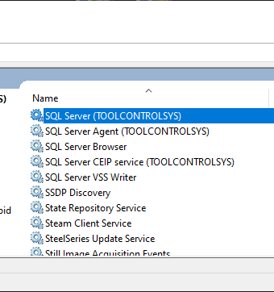
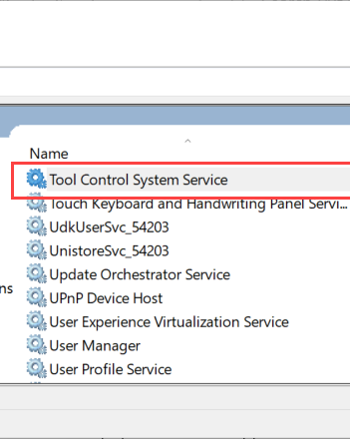
Service Computer – Windows Services
Services necessary for operation
  SQL Server (INSTANCENAME)
  Tool Control System Service
If experiencing connection issues check to make sure both are running.

Slide 15
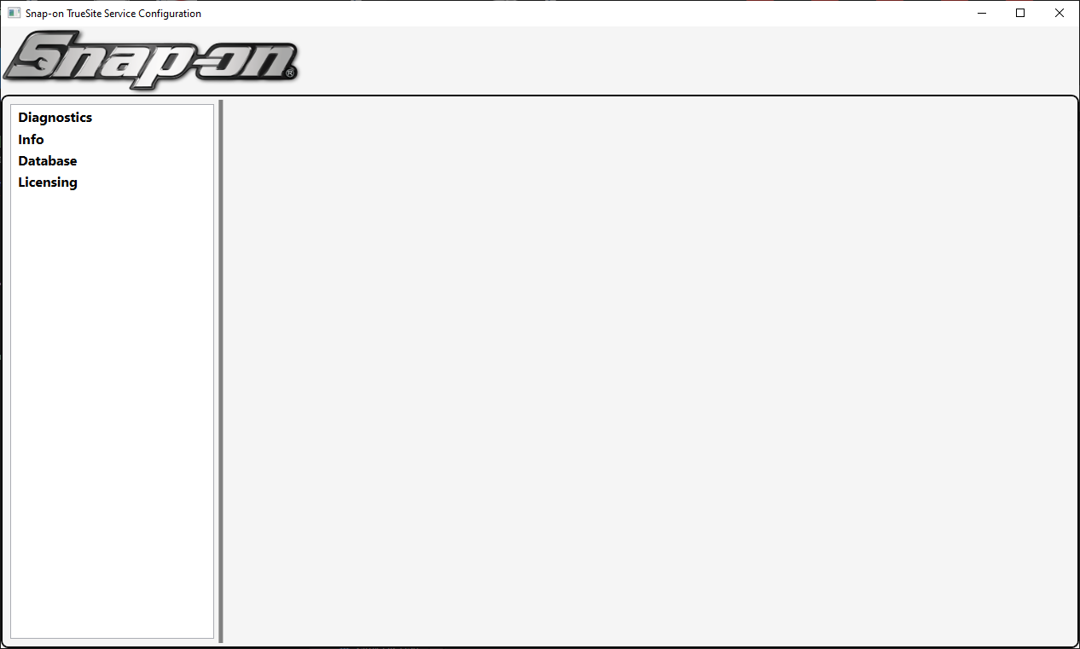
Configuring the Service
Diagnostics
  Check the status of the Service
Info
  Stop/Start Service
  Version Info
  Port Settings
  TCP/HTTPS Settings
Database
  DB Settings
  Connection Test
Licensing
  Displays current license
Notes:
When you need to make a change to the TrueSite Service, you use the TrueSite Service Configuration Tool. This tool allows you to run Diagnostics to see if a service is running correctly, get info on the status of the service, set the parameters to connect to a database, and view/update our License. This utility is on the same PC where you installed the Service.

Slide 16
Lab 1 – Install & Configure L5 Connect Service

Slide 17
L5 Connect
Admin Client Overview

Slide 18
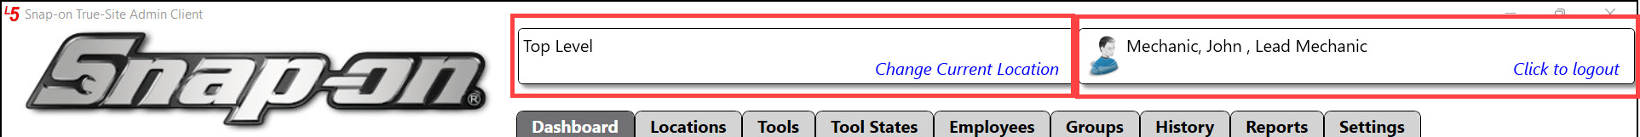
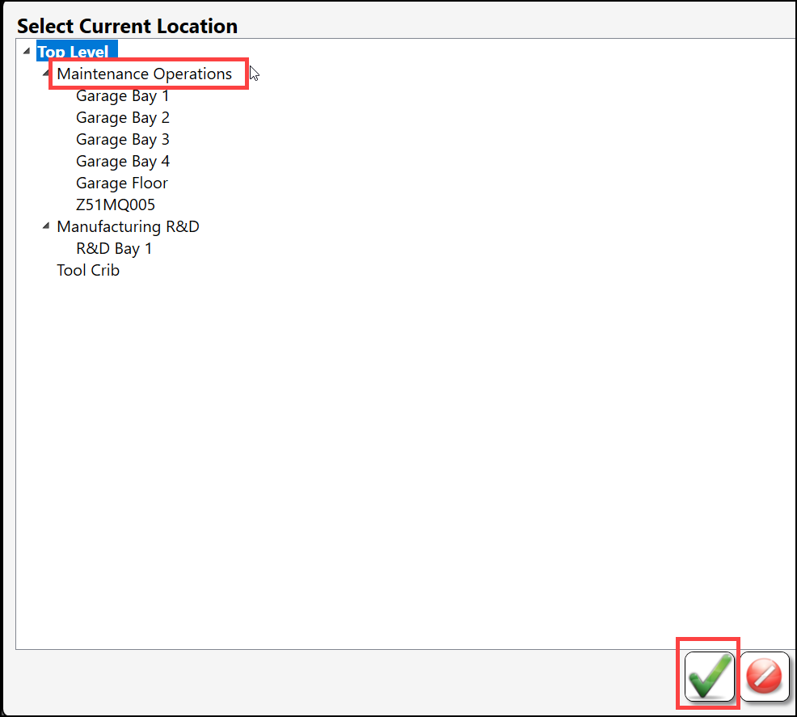
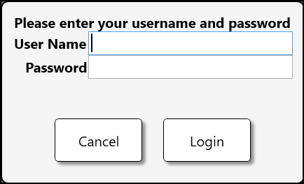
Admin Client - Command Bar
The Location View acts as a filter and determines what objects and devices you can view and modify. You can click on the Location View button to filter your view based on the location tree.
When you click the Currently Logged in User button, your session will end, and you are returned to the login screen.

Slide 19
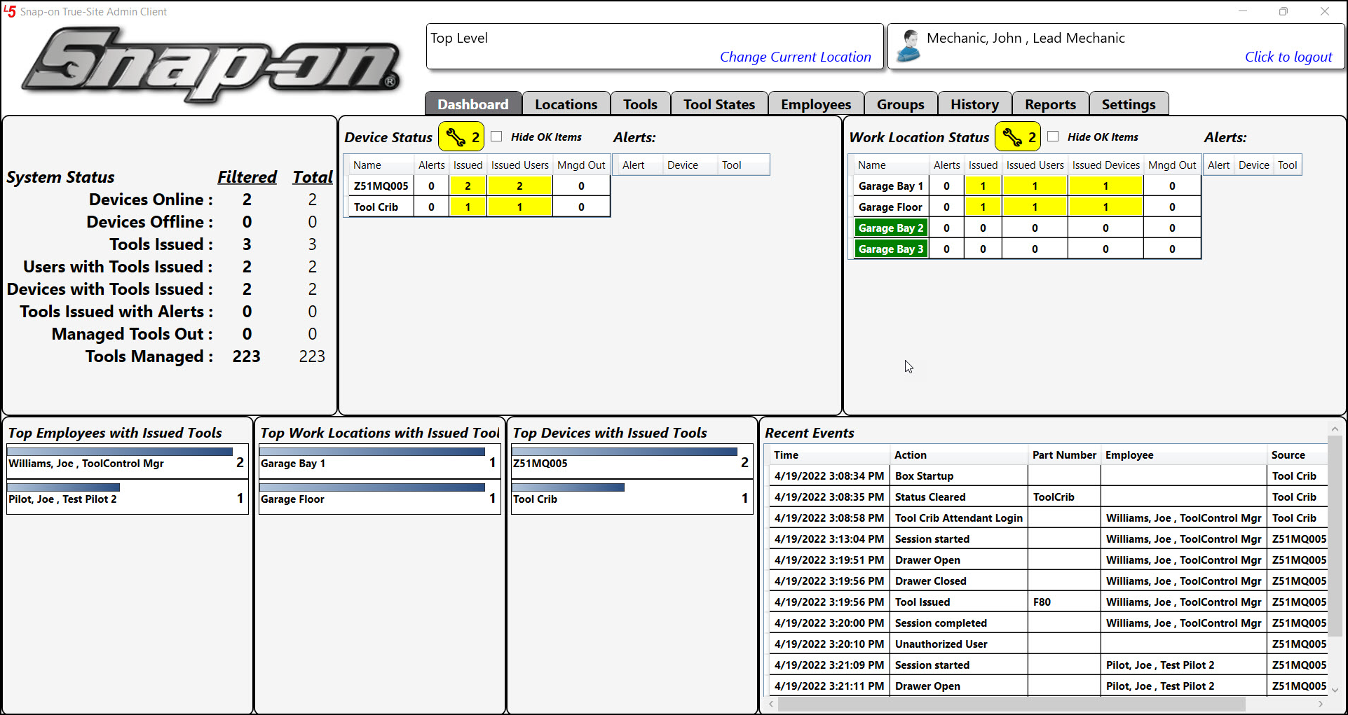
Admin Client - Dashboard
The Dashboard is the home screen of the admin client. It displays a real-time view of all the devices and alerts.
System Status
  All boxes online/offline w/issued tools
Device Status
  Alert and Tool overview of all managed devices
Work Location Status
  Alert and Tool overview of designated Work Locations
Recent Events
  Running log of system events
Top Bar Graphs
  Graphs showing live accounting of tools issued from, locations, user and device

Slide 20
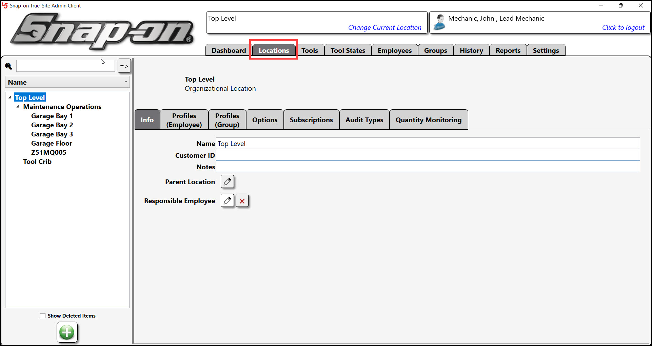
Admin Client - Locations
What are locations
  Represents a Physical Location, Organizational Unit, or Device
  Acts as management zones
Location Objects
  Organizational Location
  Work Location
  Device (Toolbox, Locker, Crib)

Slide 21
Lab 2 – Customize Dashboard & Creating Locations

Slide 22
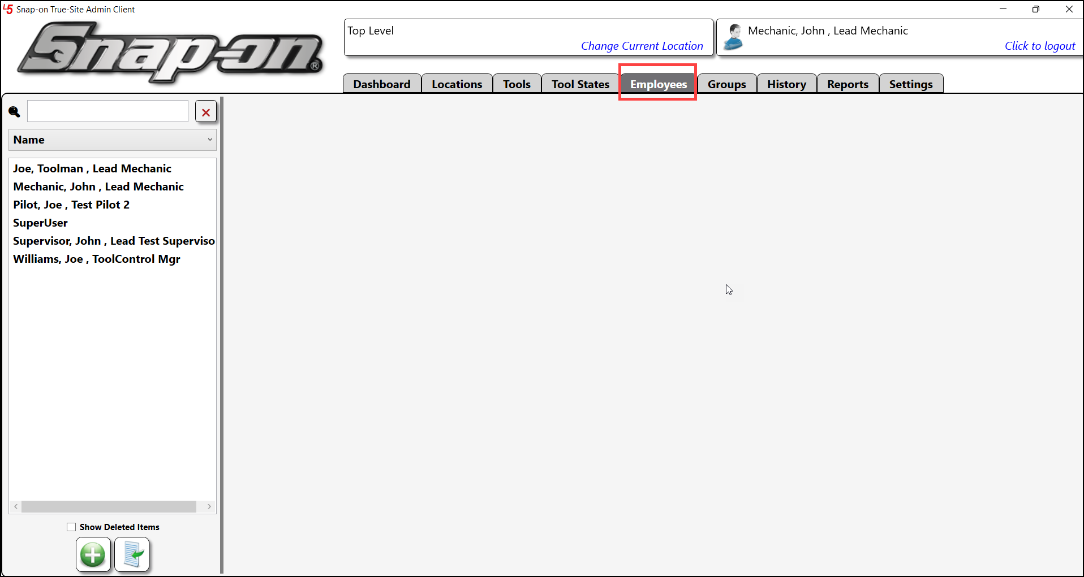
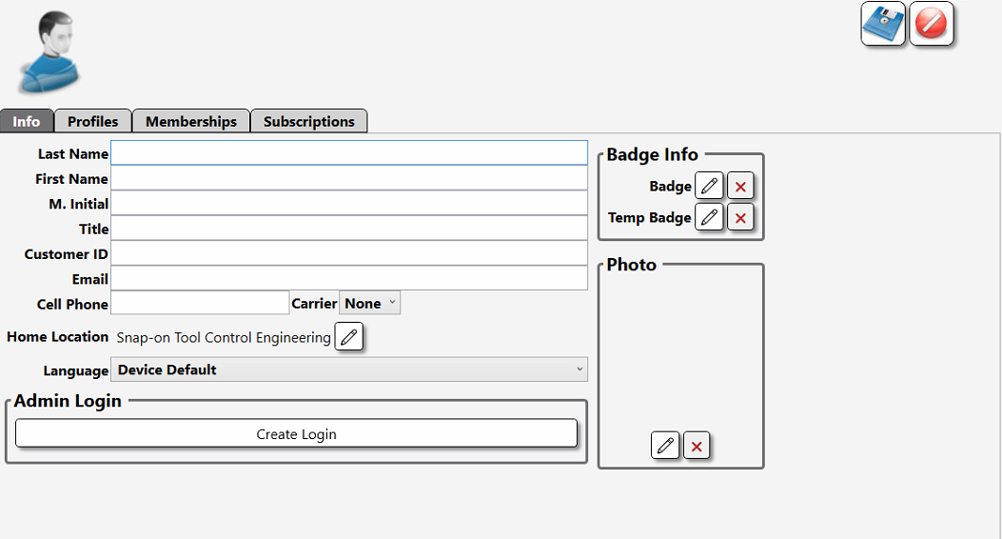
Admin Client - Employees
Employee Types
  Standard
    Used to access Devices
    Does not have a username/password
    No access to Admin Client
  Admin
    Same access to devices as standard
    Can access admin client
    Username/password

Slide 23
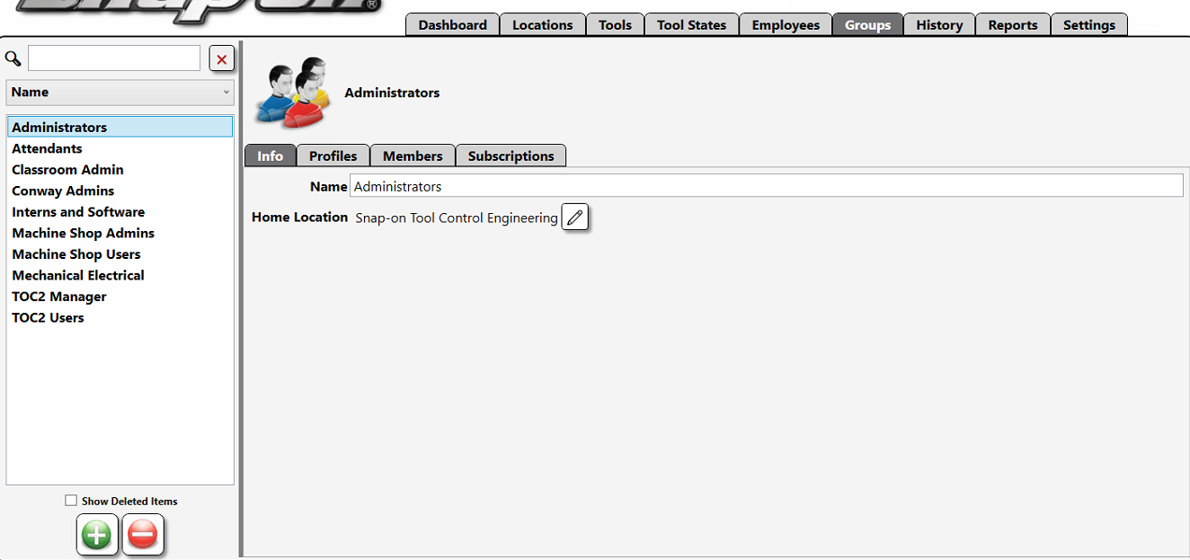
Admin Client - Groups
A way to organize a selection of Employees into a single identity
Set permissions on the Group not the Employee

Slide 24
Lab 3 – Employees and Groups

Slide 25
What is a Profile?
A set of permissions to define a Role
  Superuser
    System Administrator
    Has access to everything
  Superviewer
    Can view everything but cannot make changes
  Administrator
    Can make changes within the system but cannot make system wide changes
  Maintenance
    Administrative functions on ATC Devices
  System User
    ATC Device Access only
Notes:
So, what is a Profile?
A Profile is a set of pre-configured permissions that can be can be assigned to either an Employee or Group and is used to define a job role within the system.
There are already five built-in profiles in the system. These Profiles cannot be modified or deleted.
SUPERUSER – This Profile grants every permission in the system. It usually is used exclusively by the IT or Technical Engineer in charge of the system as a whole. This profile is the only default profile that can make system-level changes. An Employee with admin access must be assigned this profile at the Top Level of the Location Tree to function correctly.
SUPERVIEWER – This profile is granted all visibility permissions but cannot make any changes. This role is useful for management that wants to have visibility to any object within the system but does not plan on making any changes.
ADMINISTRATOR – This profile is granted most administrative permissions but cannot make system-level changes. This role is for an area or department supervisor who needs full control of the users and devices in specific locations.
MAINTENANCE – This profile is granted limited administrative permissions to devices and reports. This role is designed for the maintenance team to keep the Tool Control devices working and online.
SYSTEM USER – This profile is granted the base level permissions to the system. It has no access to any administrative functions. This role is the default role assigned to users within a location.
Again, These built-in Profiles cannot be edited or deleted.

Slide 26
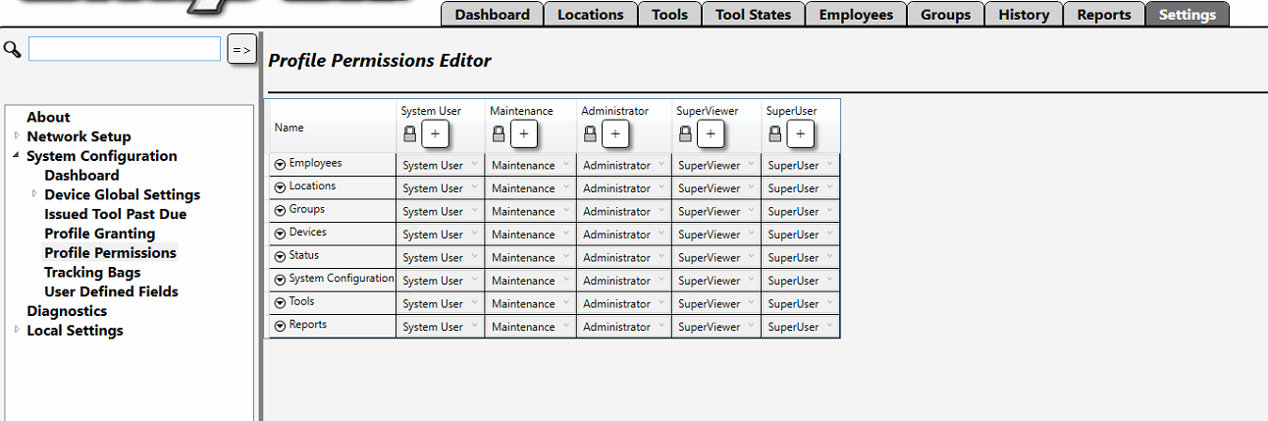
Permission Categories
Employees
Locations
Groups
Devices
Status
System Configuration
Tools
Reports
Notes:
Permissions are the rules that determine if a user or group can perform a specific function or action. These permissions are collected into list called categories that you can grant to a profile.
These categories are:
Employees – Permissions about managing employee access
Locations – Permissions about managing location objects
Groups – Permissions about managing groups
Devices – Permissions about TCS Devices
Status – Permissions pertaining to the Device States and Status
System Configuration – Permissions about Global TCS Configuration
Tools – Permissions about tools
Reports – Permissions about custom and built-in reports

Slide 27
Lab 4 – Working with Profiles

Slide 28
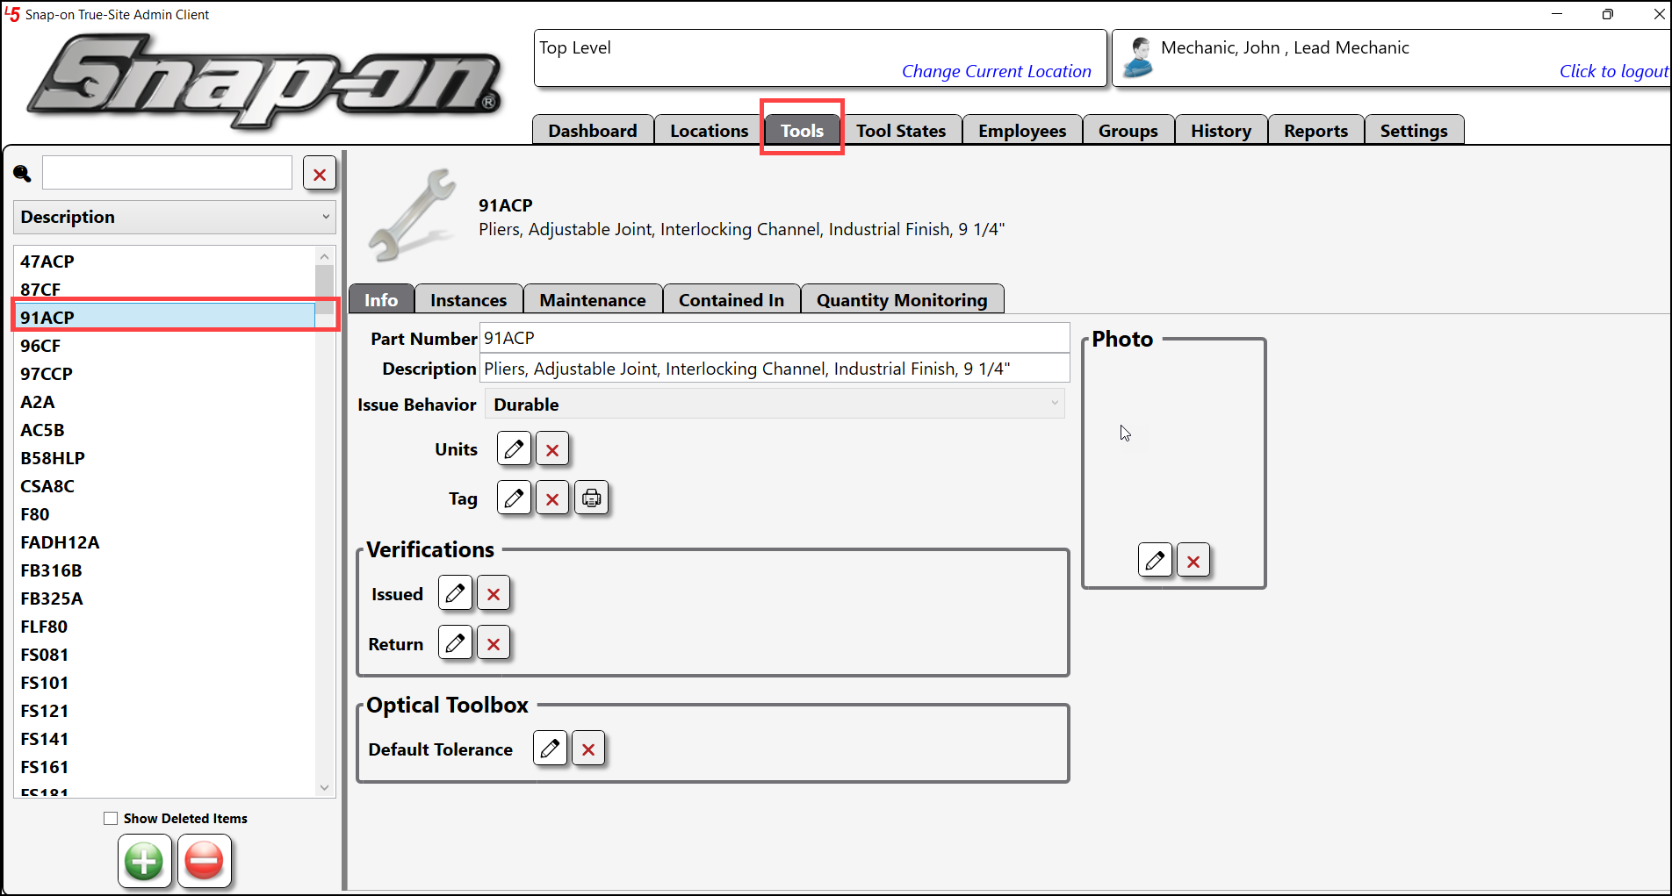
Admin Client - Tools
Master Tool
  Blueprint of what a tool is
  Settings apply to all instances
Tool Instance
  A physical tool in a device
  Must be assigned to a Master
  Inherits properties from Master

Slide 29
Master Tool Properties
Part Number – a unique alphanumeric number to identify the tool
Description – the name and description of what the tool is
Units – the quantity to be issued when checking out the part/tool
Tag – the barcode or RFID tag that will be used to ID the tool
Photo – A picture that represents the tool
Issue Behavior – How the system will handle the tool (Tool Type)
Notes:
A tool’s Properties are the attributes that define the tool and how the system handles it when someone checks one out.
Part Number – a unique alphanumeric number to identify the tool
Description – the name and description of what the tool is
Units – the quantity to be issued when checking out the part/tool
Tag – the barcode or RFID tag that will be used to ID the tool
Photo – A picture that represents the tool
Issue Behavior determines the type of tool and how TCS processes it

Slide 30
Tool Instance Properties
Customer ID – a unique alphanumeric number
Serial Number – the serial number of the physical tool the instance is being created for
Tag – if the Barcode for the Instance is different from the Master it will be defined here
Home Location – The zone on the location tree that this Instance will reside primarily
User Defined – Custom property that can represent whatever you want
Notes:
Instances also have a set of properties that can be defined as well. These properties are unique to that instance only.
Customer ID – a unique alphanumeric number
Serial Number – the serial number of the physical tool the instance is being created for
Tag – if the Barcode for the Instance is different from the Master it will be defined here
Home Location – The zone on the location tree that this Instance will reside primarily

Slide 31
Tool Behavior
Durable – A Tool that can be returned and used again
Kit – A collection of tools that are issued together
Consumable – A Tool that is disposed of after use and not expected to be returned
Returnable Consumable – A tool that must be returned to ensure proper disposal
Notes:
The Tool types that are used in the system are listed here. When creating a Master, you define the tool type. Once selected you cannot change it.
Durable – A Tool that can be returned and used again
Kit – A collection of tools that are issued together
Consumable – A Tool that is disposed of after use and not expected to be returned
Returnable Consumable – A tool that must be returned to ensure proper disposal

Slide 32
Kits
A Tool that contains several sub-tools
Behavior must be set to Kit in order to use Kit tab.
When an instance of a kit is created, it also creates instances of the sub tools it contains.
Notes:
Toolkits allow us to create a bundle of tools that can be issued out as a single instance. This is useful when you have a standard tool loadout that is issued to Employees frequently.
A kit is a tool that contains several sub-tools.
In order to create a kit, the issue behavior of a Master must be set to kit.
When you create a Kit instance, an instance for each sub-tool is also created.

Slide 33
Lab 5 – Working with Tools

Slide 34
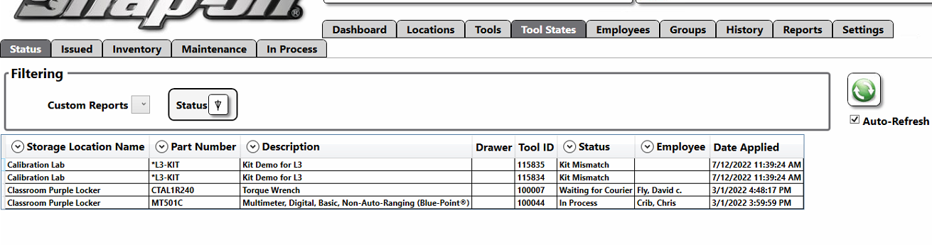
Admin Client – Tool States
A real-time view of the tool inventory
Sub-Tabs are pre-generated reports that can be filtered
  Status – list of the ATC Devices and tools with Status active
  Issued – list of all tools currently issued out
  Inventory – list of all instances of tools in the system
  Maintenance – list of all tools with a maintenance status active

Slide 35
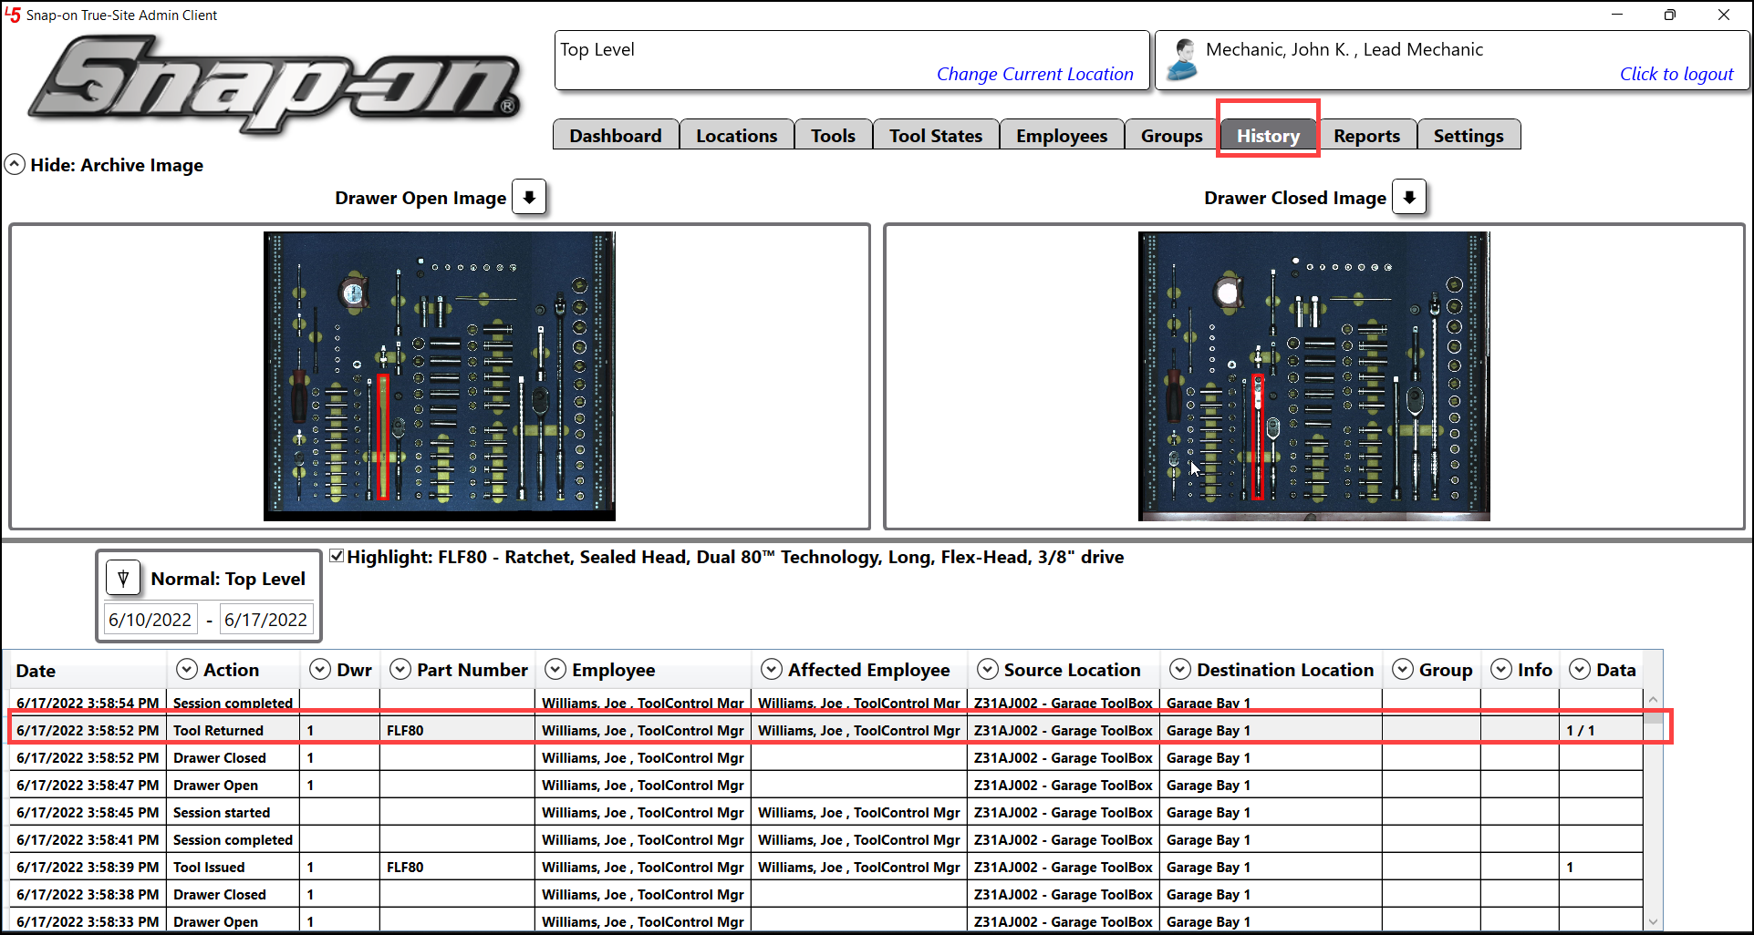
Admin Client - History
Record of all events
  Drawer open/closed image
  Event data
  Filter and sort columns
  Set Date Range

Slide 36
Lab 6 – Using History & Tool States

Slide 37
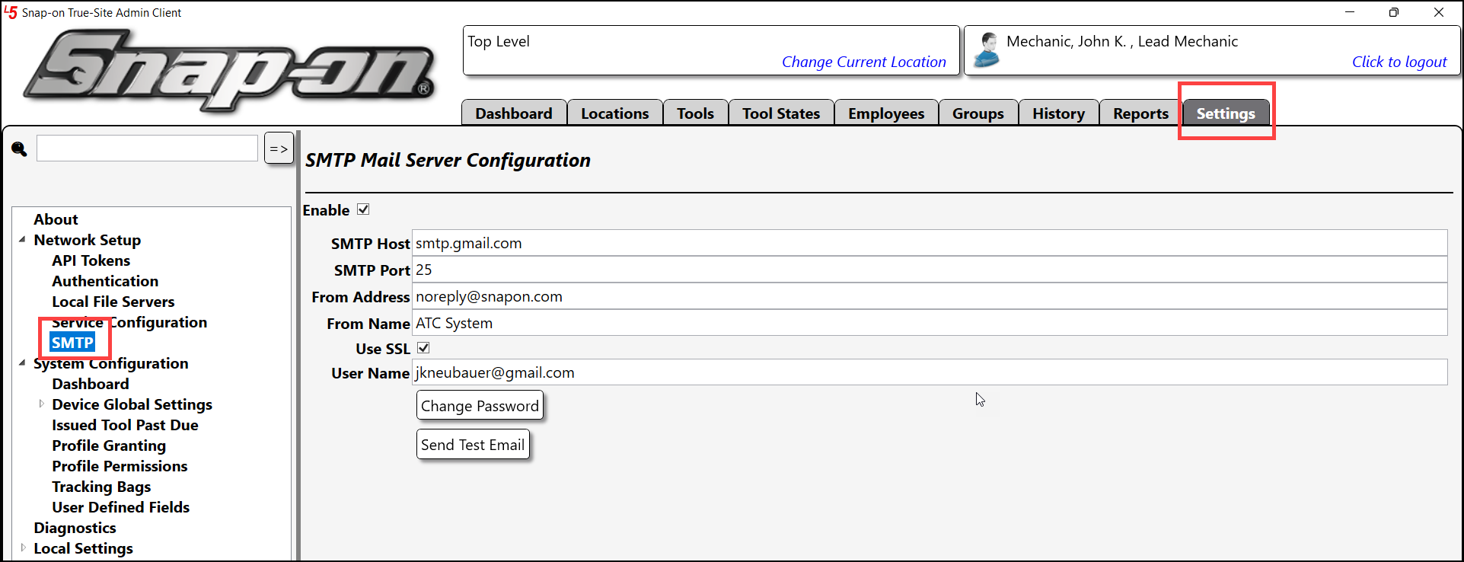
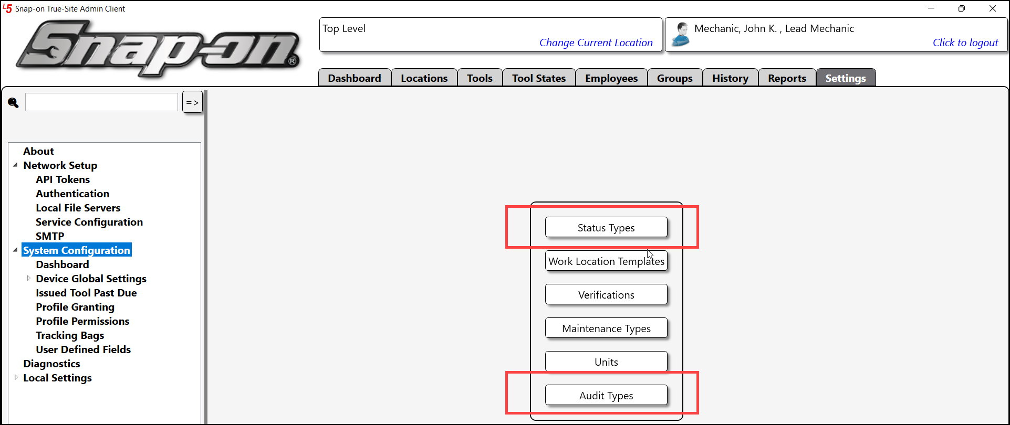
Admin Client - Settings
View and customize system
Network Setup
  Issue API Tokens
  Set Authentication Type
  SMTP
    Define mail server for notifications and scheduled reports
System Configuration
  Create global objects
  Define permissions

Slide 38
L5 Connect
Reports in Detail

Slide 39
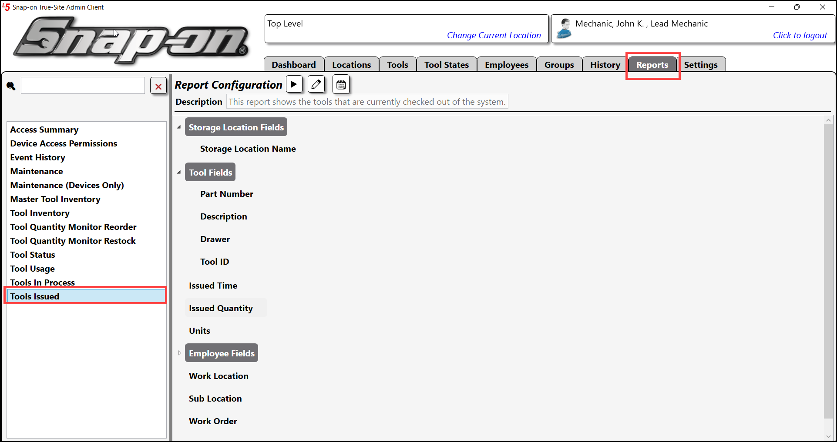
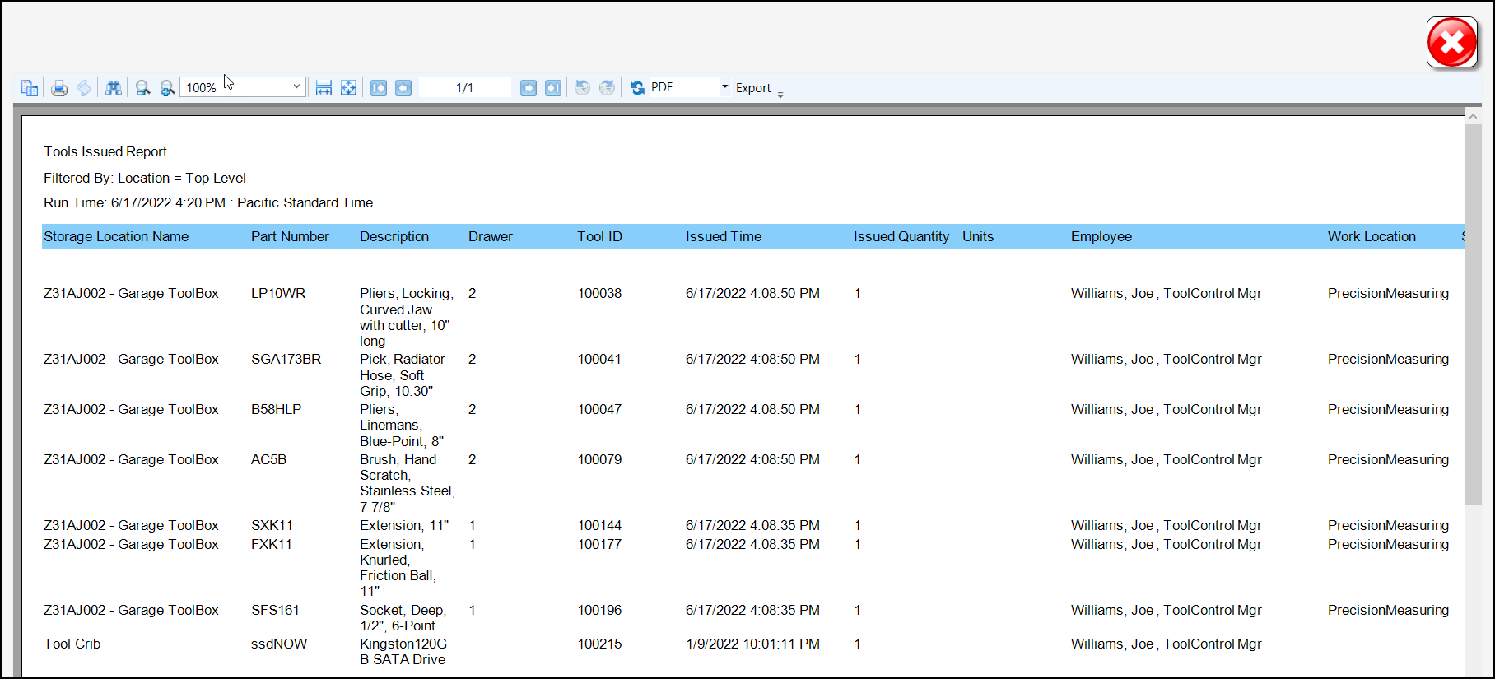
Reports - Overview
Built-in Reports
  13 reports
  Customize Reports
  Select an existing report to edit
  Save and Share custom report
Report Export
  PDF
  XLSX (Excel)
  RTF
  Print
Can be scheduled to run automictically

Slide 40
Lab 7 – Customized Reporting

Slide 41
L5 Connect
Alerts and Notifications

Slide 42
What are Subscriptions?
Automated messages that are generated based on a status
  Alert Notifications
  Email or SMS Text Message (US ONLY)
3 options for both methods of delivery
  Email / Text All Statuses
  Email / Text Alerts
  Custom Selection
Can be set at 3 different levels
  Employee
  Group
  Location
A valid SMTP server is needed to send emails and text
Notes:
When a device has issues, you may not be around to see it. Subscriptions allow you to stay informed about what is happening with your TrueSite Devices and users. Subscriptions are automated messages that are generated based on a status. It can be sent either as an email or an SMS Text Message (US ONLY FOR TEXT). You can select what types of messages you want to receive in the Subscription Configuration Dialog.
There are 3 options for what kind of notifications you can receive:
Email/Text All Statuses – You will receive an email or text whenever a status is flagged on the device.
Email/Text Alerts – You will receive an email or text whenever a status is flagged on the device that has its behavior set to ALERT.
Custom Selection – You can define which status types you will be messaged on when they are flagged.
Like Profiles, there are three methods you can use to create a subscription: Employee, Groups, and Locations. When you create a subscription from the employee or group screen it will automatically be set to whatever is the currently selected location.
In order for the Subscriptions to send out any messages, you must configure TrueSite to use a valid email server and texting service. You also need to add at least one email for the employee getting the notifications in the employee information screen. You can set an Employee to have multiple emails separated by semi-colons (;).

Slide 43
Status Types and Behavior
Status Types to inform you of the current state of the device
  Lost
  Offline
  Wrong Tool
How a status is categorized is defined by its Behavior
  Info Only – Only shown on details page
  Warning – Shown on Main screen on Device
  Alert – Appears on Front Screen and Dashboard, Will trigger alert Notification
  Managed Out of Box – Shown on Front Screen, Hides from Tool Count and Reports.
Notes:
To understand how to create and configure Subscriptions, you must first understand what a Status Type and Behavior is. The TCS system uses Status Types to inform you of the current state of the device. This can be anything from missing or misplaced tools to maintenance alerts. How a status is categorized is defined by its Behavior. The types of behavior are:
Info Only – Only shown on details page
Warning – Shown on Main screen on Device
Alert – Appears on Front Screen and Dashboard, Will trigger alert Notification
Managed Out of Box – Shown on Front Screen, Hides from Tool Count and Reports.
You can change the behavior of a Status by going to Status Types in System Configuration

Slide 44
Lab 8 – Setting up Alerts

Slide 45
L5 Connect
Maintenance Plans

Slide 46
Tool Maintenance
Set Maintenance status based on several factors
  Days
  Maintenance Cycles
  Issues
  Uses
Can set warning date and overdue date
Set on a Master
  Dates are defined on Tool Instance
Notes:
You may have some tools that need to be maintained or calibrated every so often. Keeping track of this manually can be cumbersome and tedious. You may also miss some maintenance periods due to lack of accurate maintenance records. TrueSite automates most of this. It can keep track of what tools need to be serviced and how long tools have gone without service.
You can set your Maintenance schedule based on several Factors
Days
Main Cycles – This is for # of Main before this get triggered
Issues – This is the number of issues before the tool is flagged for maint
Uses – This keeps track of how many times a tool is used before it needs maintance
Warning Dates and Overdue dates can be set
A Maintenance schedule is set on a Master.

Slide 47
Lab 9 – Setting up Maintenance

Slide 48
L5 Connect
Toolbox Overview

Slide 49
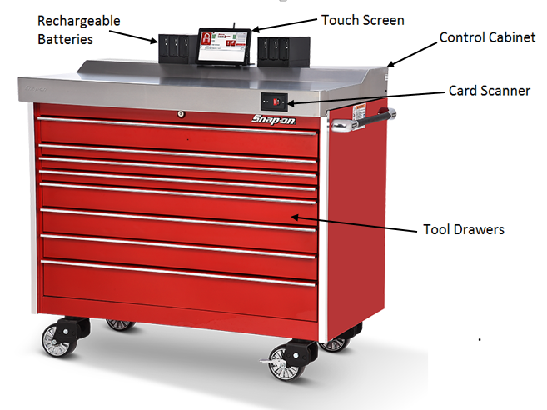
ATC Toolboxes
Uses cameras to determine the presence and absence of tools
Produces and stores drawer images that can be used for visual confirmation of the automated system
Rechargeable model will run for ~16 hours on battery power
ATC “Zoom ID” may be used to specifically identify serialized tools

Slide 50
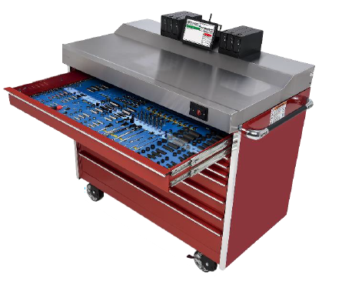
ATC Toolbox – Physical Items
Power
  Restart button located behind monitor (New systems).
  5 to 8 second hold will perform hard power down of system.
  1 to 2 second hold will power on system
Front-Surface Mirror
  Mirror is located under front of toolbox top.
  Installed at 45-degree angle to allow cameras view into drawer
  Needs to be kept clean from oil and grease smudges as well as heavy dust. Clean with filtered water & micro-fiber lens cloth, don’t use alcohol-based cleaners.
Card reader front right – User login / logout
In Drawer Dot Strips
  System uses these for drawer location and tool alignment
  Need to keep tools and items off strips otherwise will receive drawer scan errors. Can happen with empty drawers when used for storage.

Slide 51
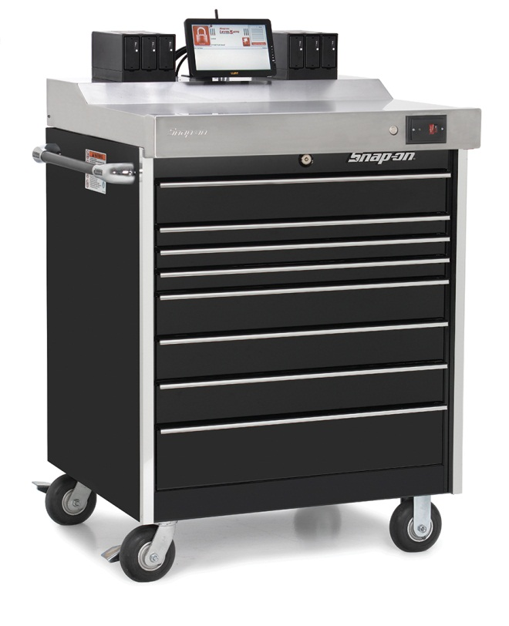
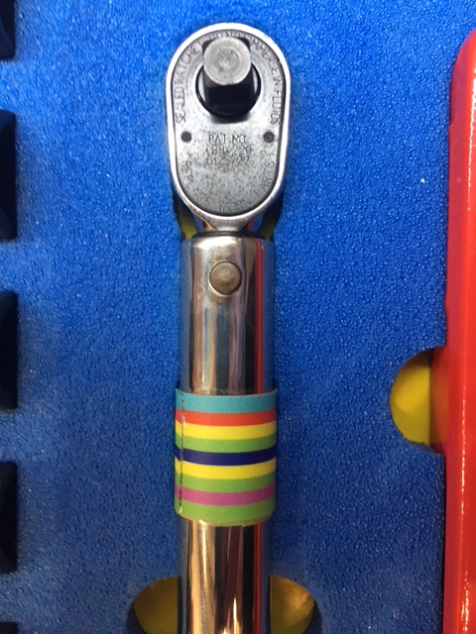
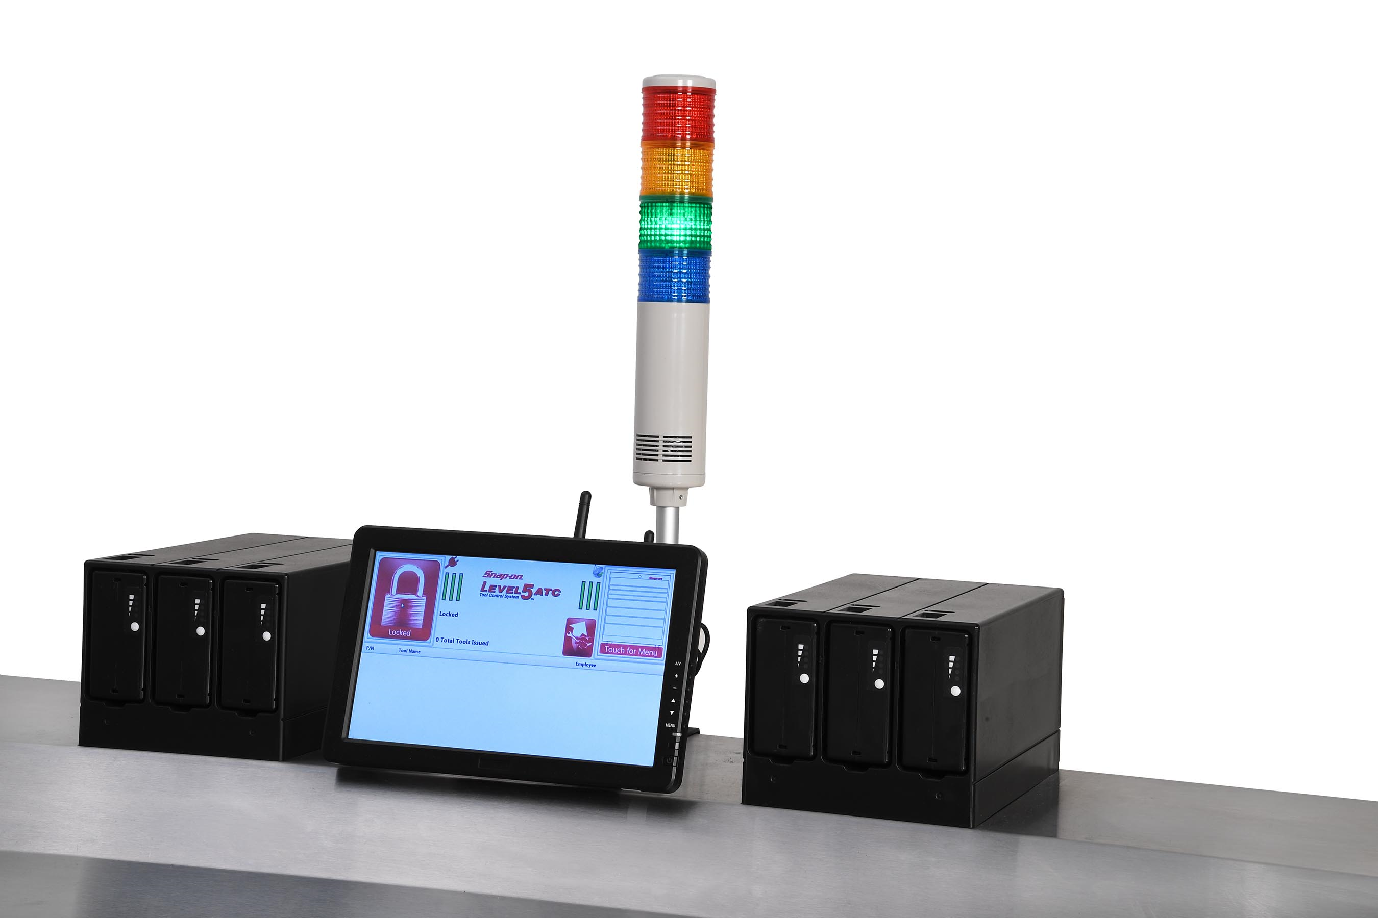
ATC ZoomID & FastFlag
ATC Fast Flag
Provides Real Time Visual
System Status Feedback
ATC Zoom ID
Track Specific “Serialized, Certified,
And Calibrated Assets

Slide 52
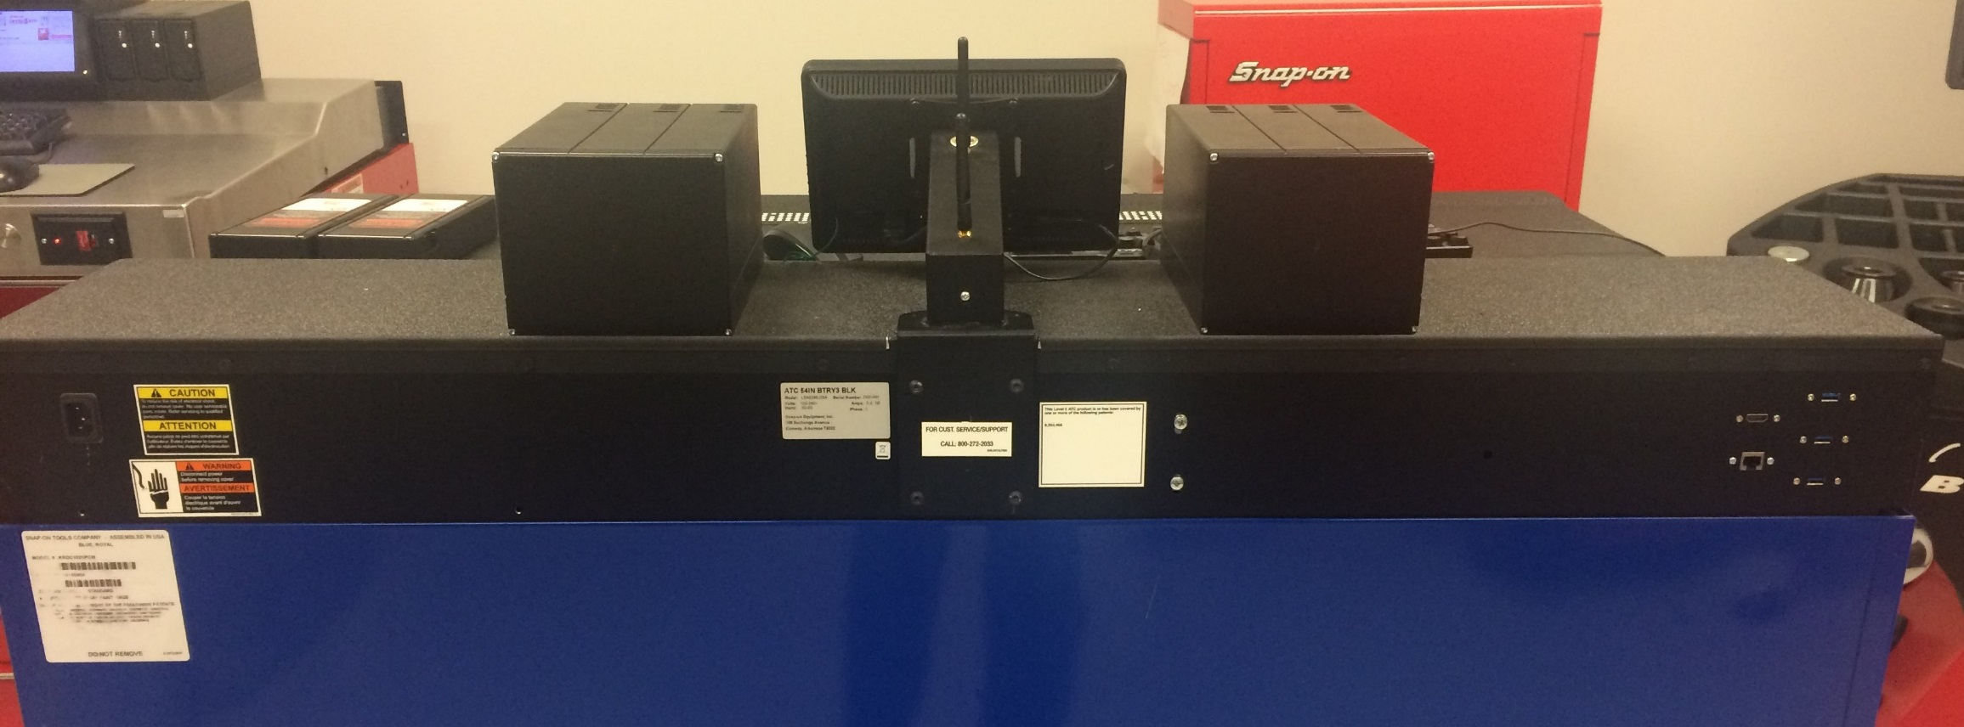
Serial Numbers
Serial numbers are located on the rear panel of the ATC electronics enclosure mounted on top surface of the toolbox or locker
Serial Label

Slide 53
Serial Numbers
Serial numbers include identifiers for
  Model number
  Build configurations
  Date of manufacture
Serial numbers and install dates are used
  To establish factory warranty start date
  As device identifiers internally by the ATC system and service
Serial numbers should ALWAYS be provided when contacting Snap-on for warranty or service inquiries
The ATC Technical Support Desk can be reached at 800 262-2033

Slide 54
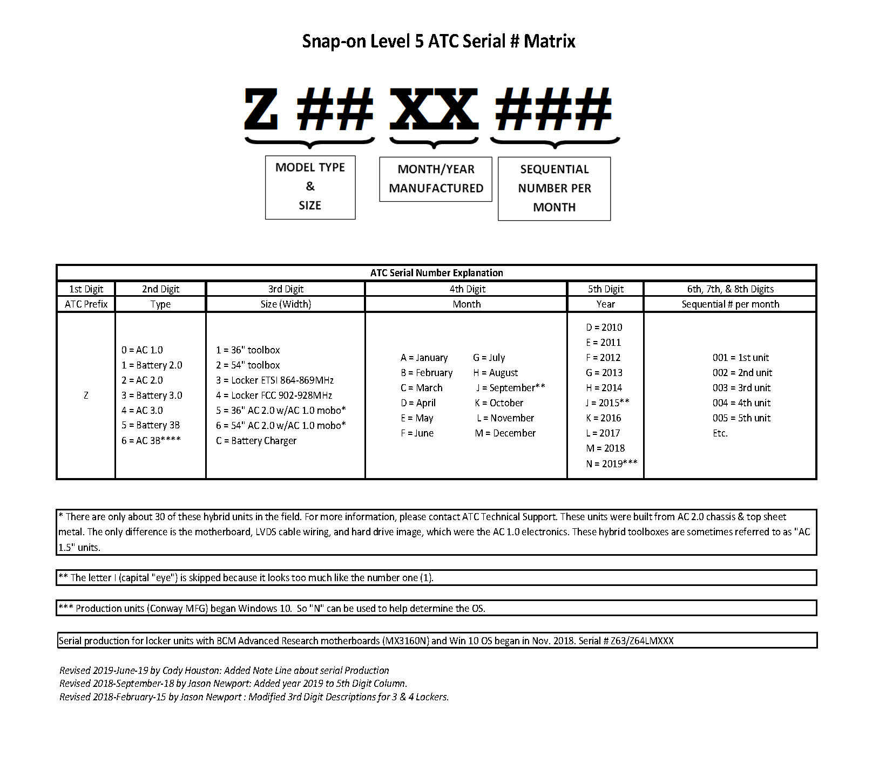

Slide 55
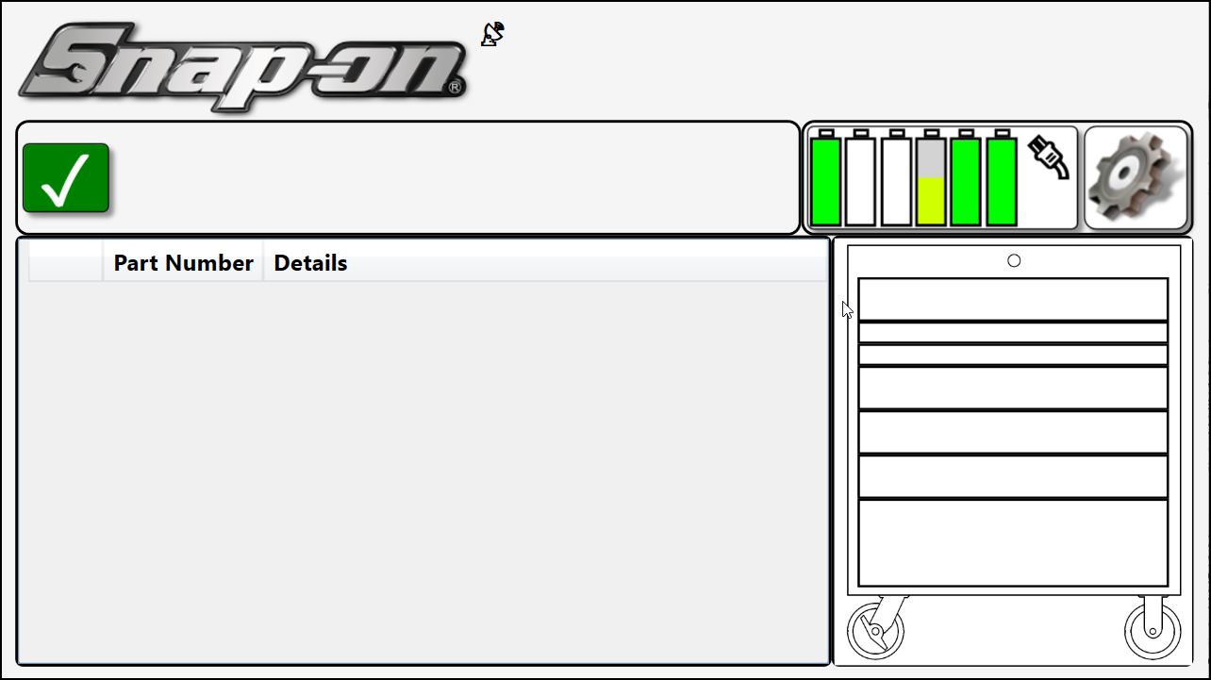



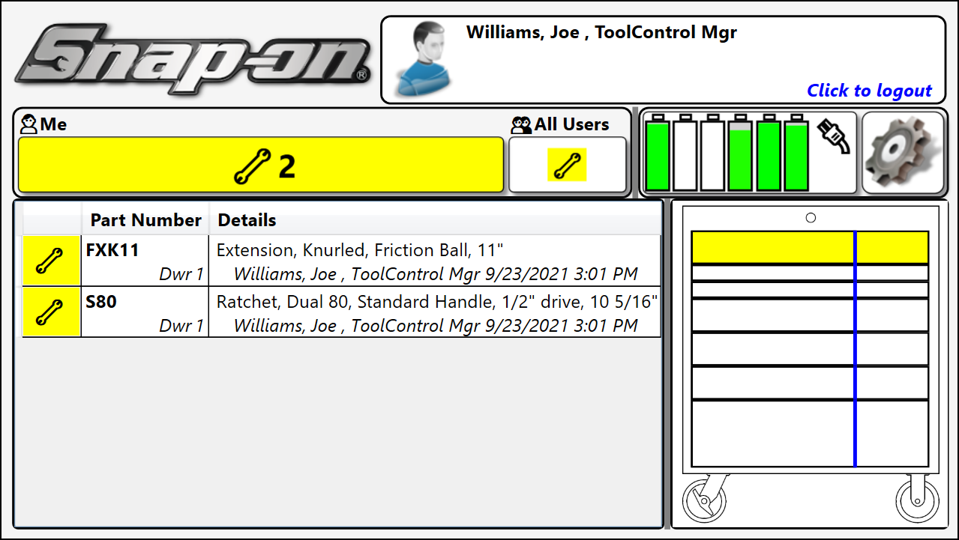


ATC Toolbox – Front Panel Descriptions
Toolbox - Monitor
  Visually displays real time drawer status/conditions
    Blank / White no tools checked out
    Yellow tools removed from specific drawer
Icons
  Battery Indicators (if applicable)
  Network Connection to Server (On/Off)
  Power Indicator
  Setup Provides access to advanced items
  All Clear – no alarms or tool statuses exist
  tool issued – will display for each tool removed
Layout
  User who is currently logged in
  Tool list at bottom lists tools checked out of toolbox

Slide 56
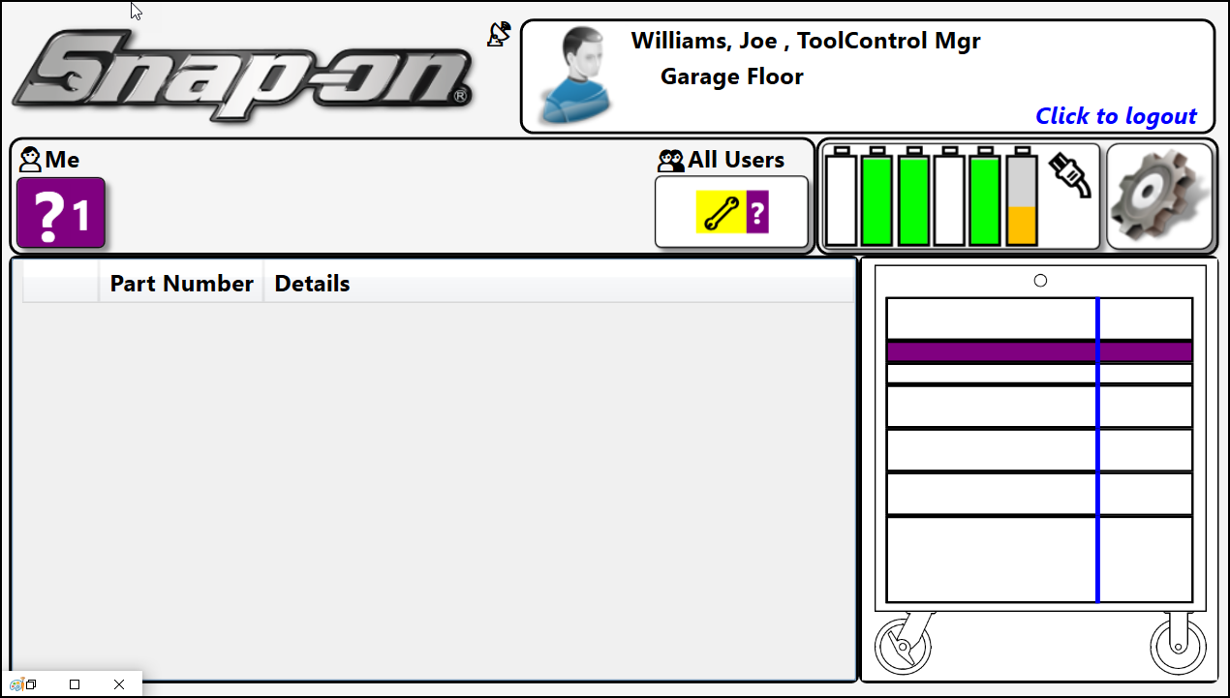

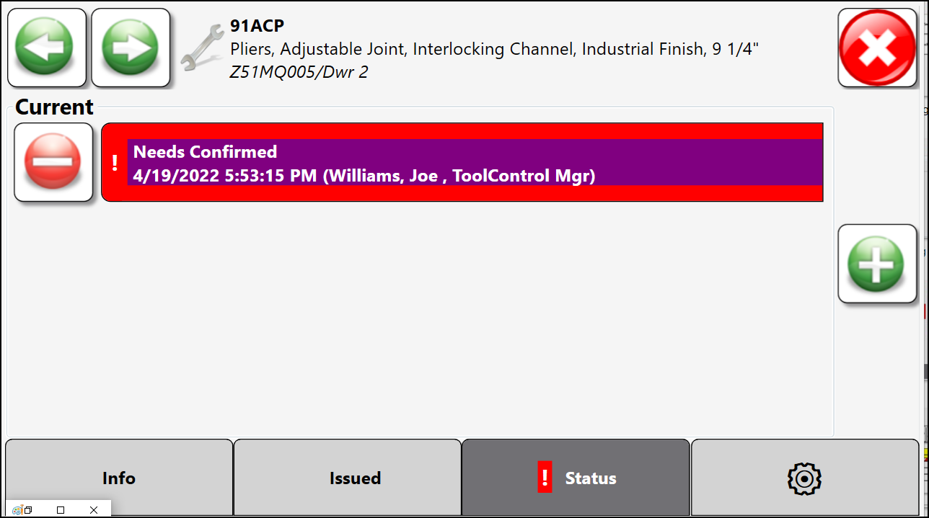
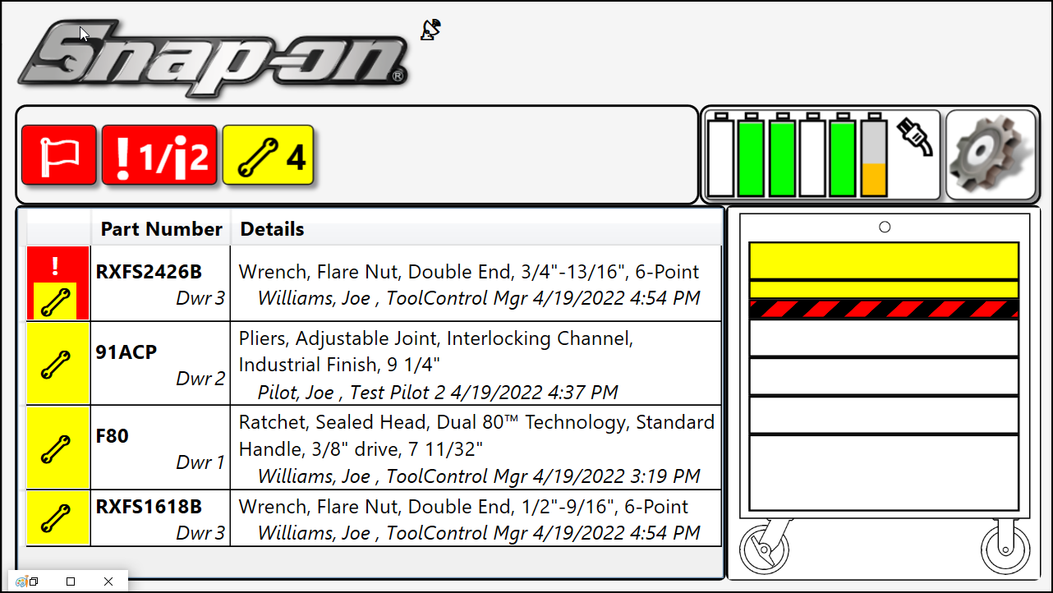

ATC Toolbox – Drawer Alert Descriptions
Drawer Alert Color Conditions
  White – clear status
    Nothing checked out & no other conditions
  Yellow Drawer alert
    Tool issued (removed), no other conditions.
  Red / White Drawer alert
    Caused by wrong tool
    Calibration or inspection overdue
    Tool not seated in foam properly (wrong tool)
  Red / Black Drawer alert
    Caused by bad drawer scan – drawer not opened all the way when required
    Debris on dot strips or camera’s not seeing dot strips
    Incomplete scan
    Drawer training may be required.
  Purple Drawer Alert
    Tool needs to be confirmed, user didn’t acknowledge
Display Status Bar
  Alert flags are clickable and provide additional information

Slide 57
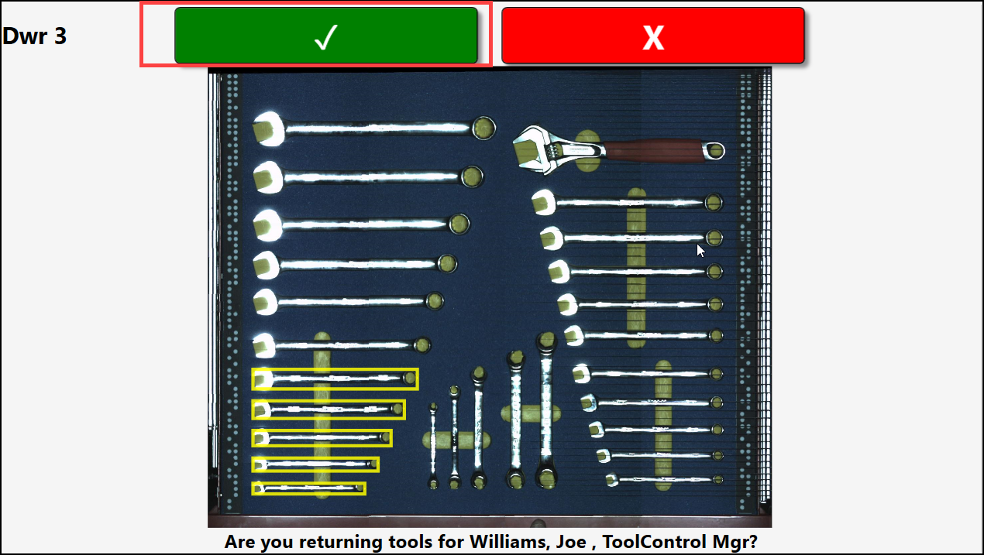
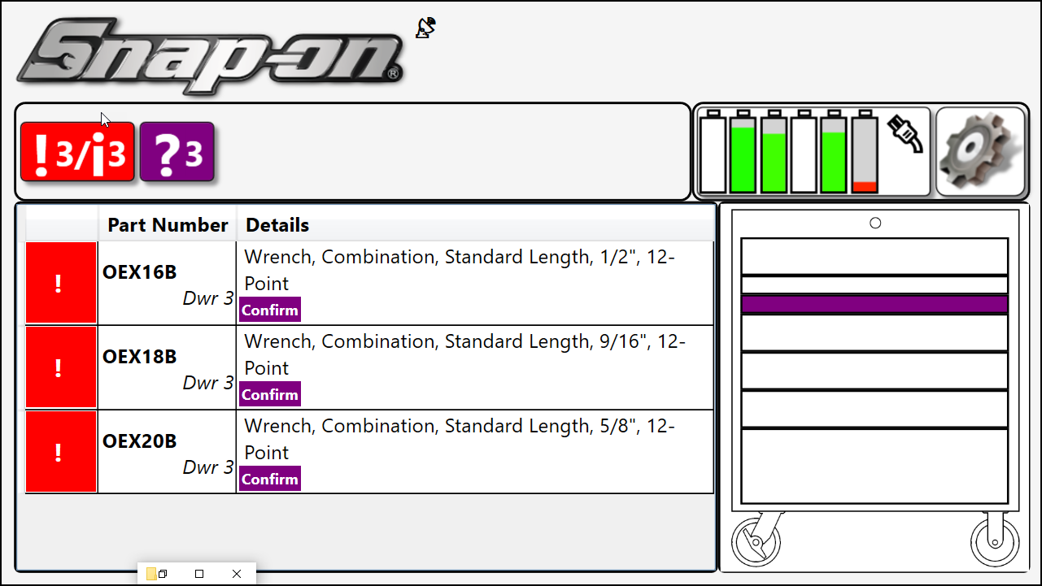
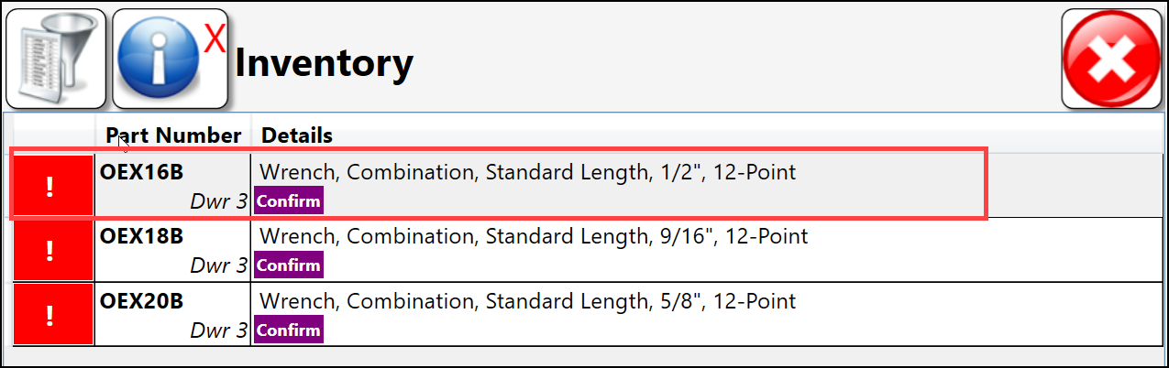


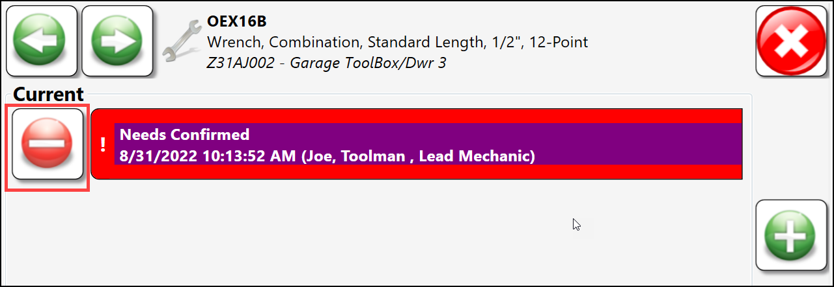

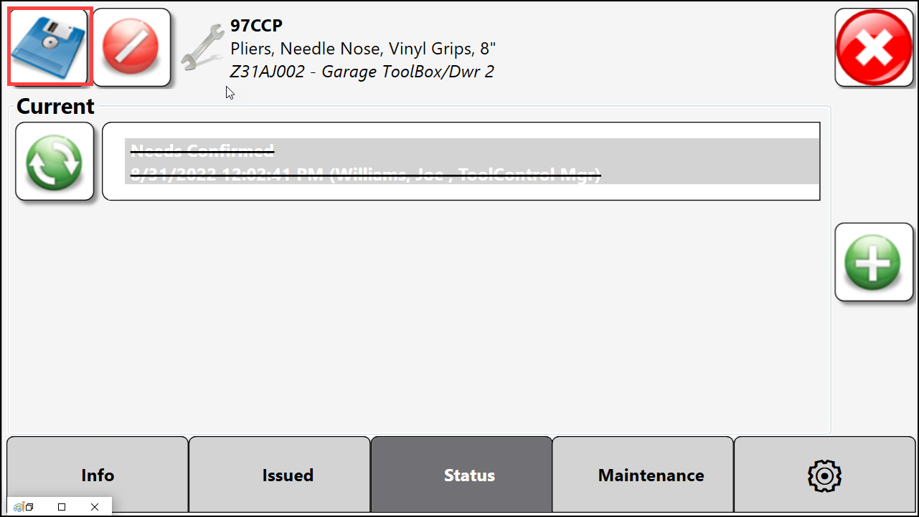
ATC Toolbox – Alerts – Confirm Declined
Confirm Declined
  User can stop them from happening by Selecting Yes, they are returning for someone else.
  caused by enabling “Prompt on check in of another user's tool” under Boxes → ATC Options
  selecting this features ensures audit trail of tool, but end user needs to acknowledge he/she are returning for another user, if not the error is created.
Clearing – Confirm Declined errors – On ATC
  Select the Alert or Confirm button on front screen.
  Select the/an Confirm Declined instance on pop up.
  Select the clear button
  Select the save button to remove error
  Close remaining windows to get to front panel. Error should be removed.

Slide 58
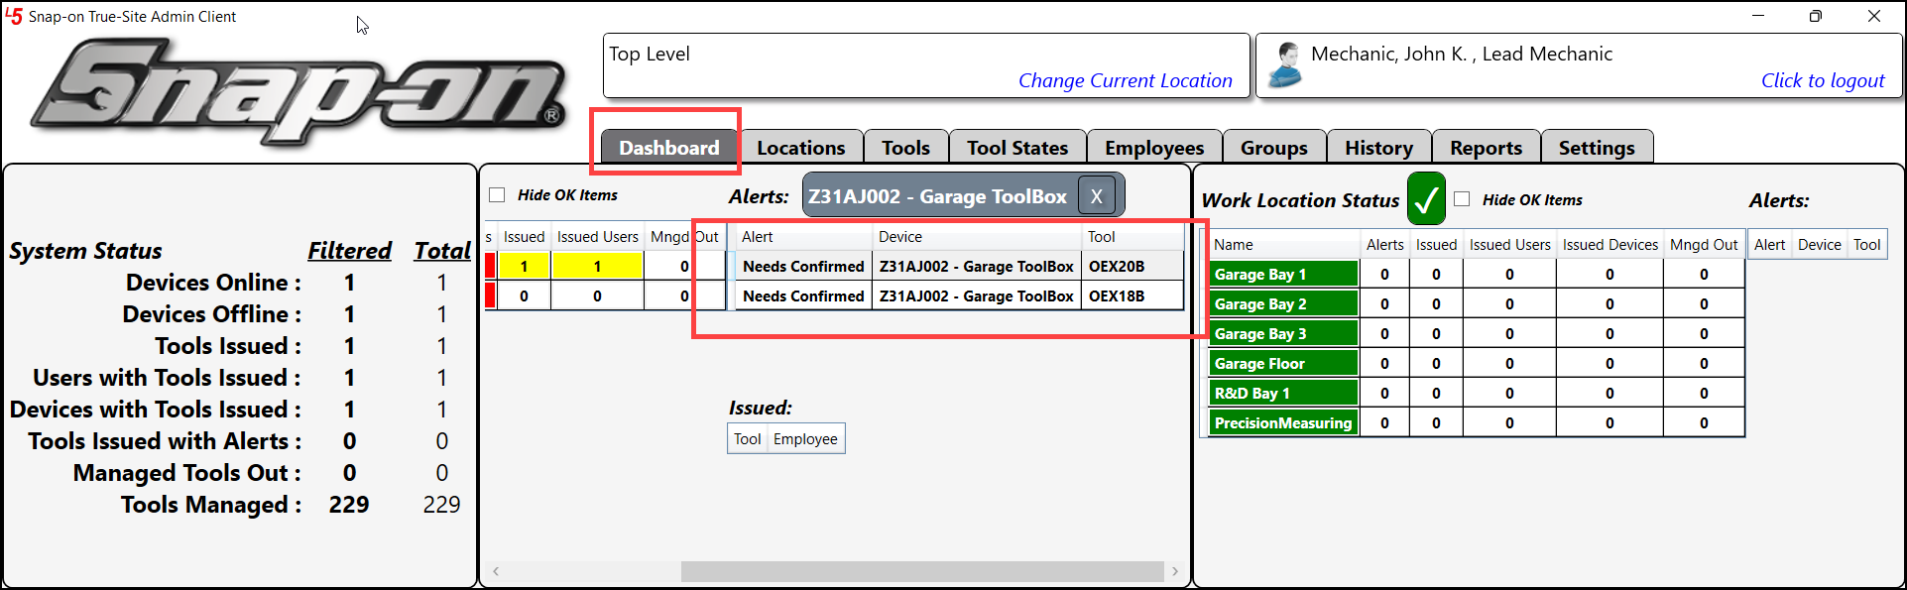
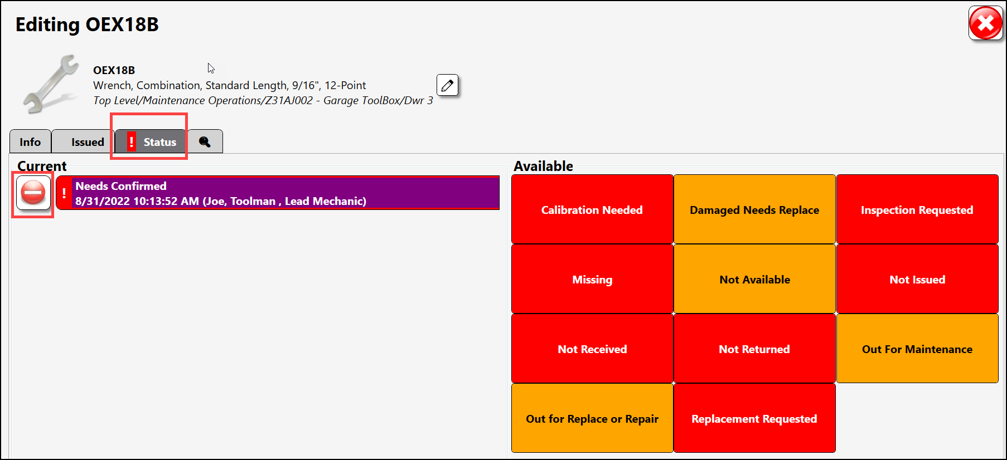
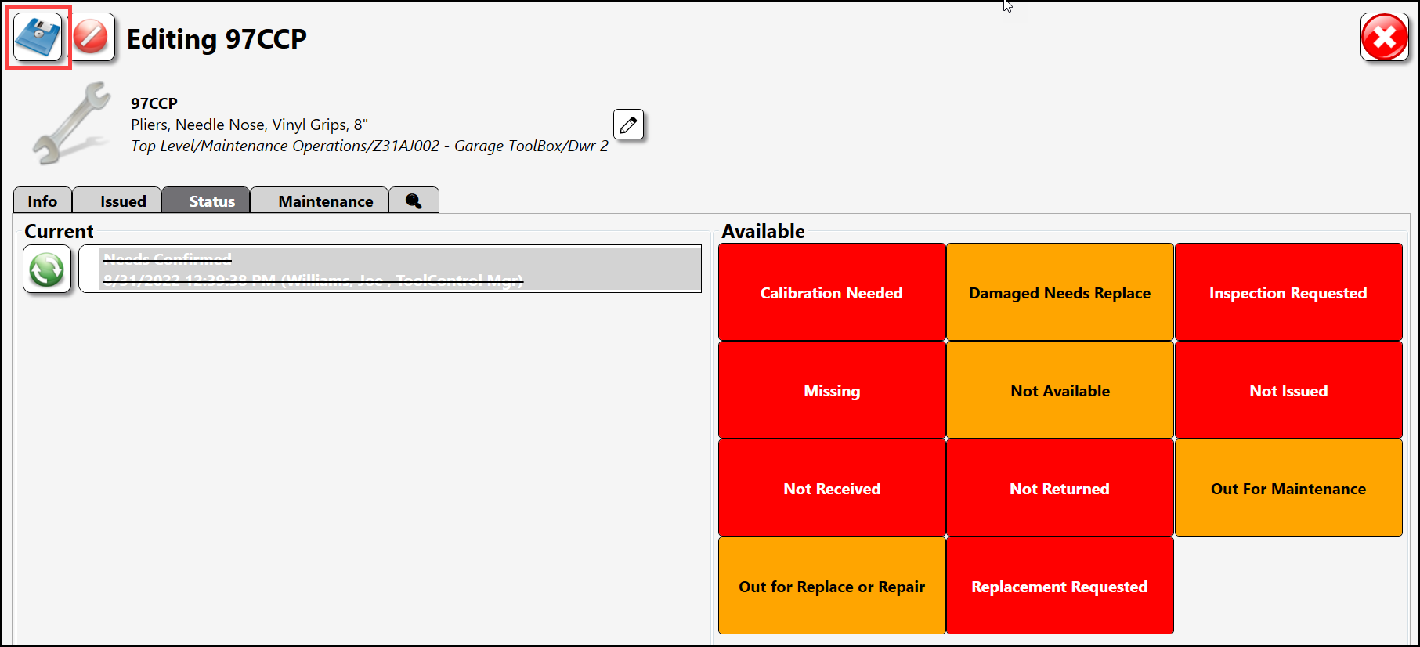
ATC Toolbox – Alerts - Confirm Declined
Clearing – Confirm Declined errors – On Admin Client
  On the Dashboard double click the Confirm error
  On the Tool popup
    Select Status
    Select the clear button
    Select save button to remove error.
  This individual error is now cleared, there may be more.
Note – only Users with Superuser, Administrator or Maintenance status profile can clear a Confirm Declined error

Slide 59
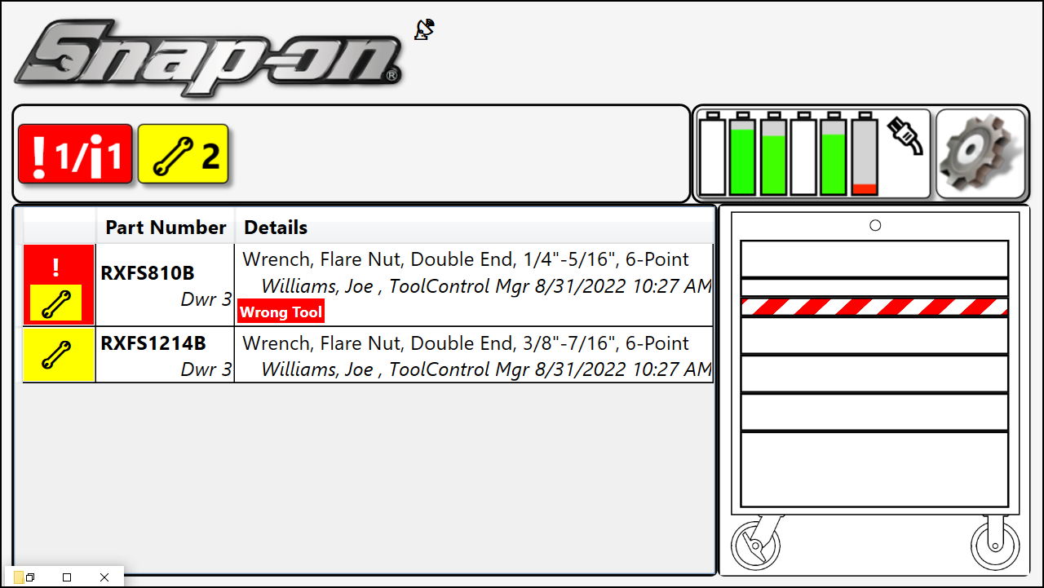
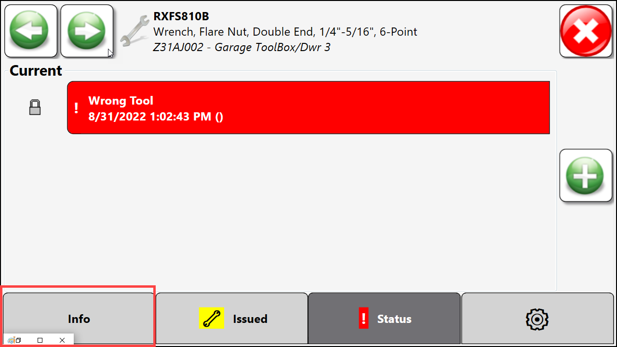
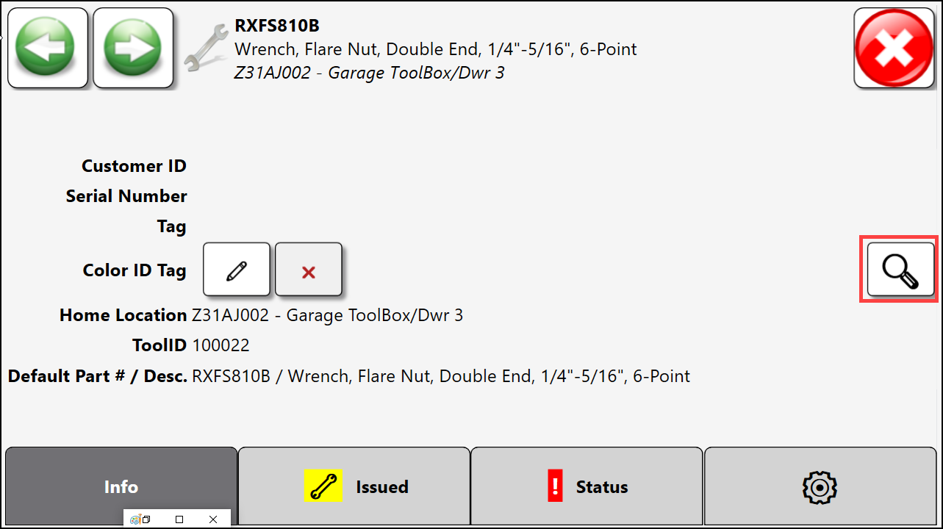

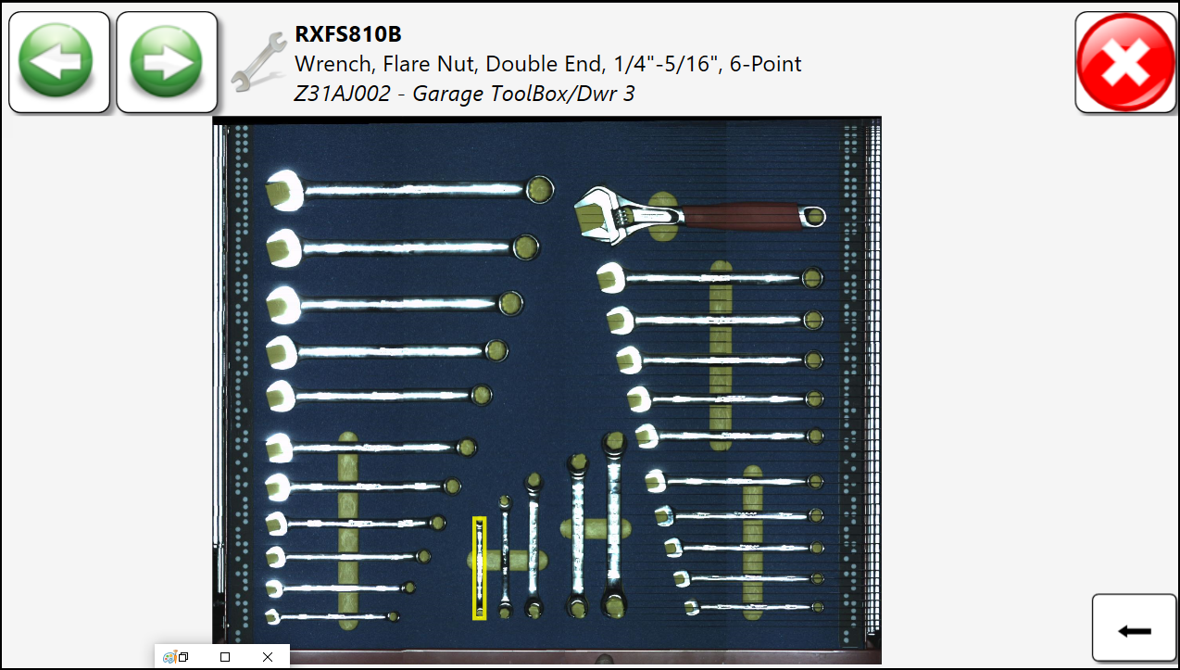
ATC Toolbox – Alerts - Wrong Tool Errors
Wrong Tool error - Causes
  Toolbox is unable to determine if the tool was present or absent.
    Tool misaligned or wrong tool is in foam pocket
    Tool has an altered appearance (dirty handle, broken tool, tape or grease on tool…)
    Camera mirror can be dirty affecting view.
Wrong Tool error – Corrections
  Alerts will clear when issue is corrected, can not just “clear” a wrong tool Alert.
  In this example a single tool has wrong tool alert in drawer 3.
  Verify the tool location by double clicking on the error message.
    Task Status window will appear, Select Info.
    Select to verify tool location
      Verify tool is in foam correctly
      Verify tool has not visually changed from last Drawer Training, like tape or grease on portion of tool
    Clean system mirror
  If these don’t correct the problem, perform either individual tool retrain or lower tool tolerance.
59

Slide 60
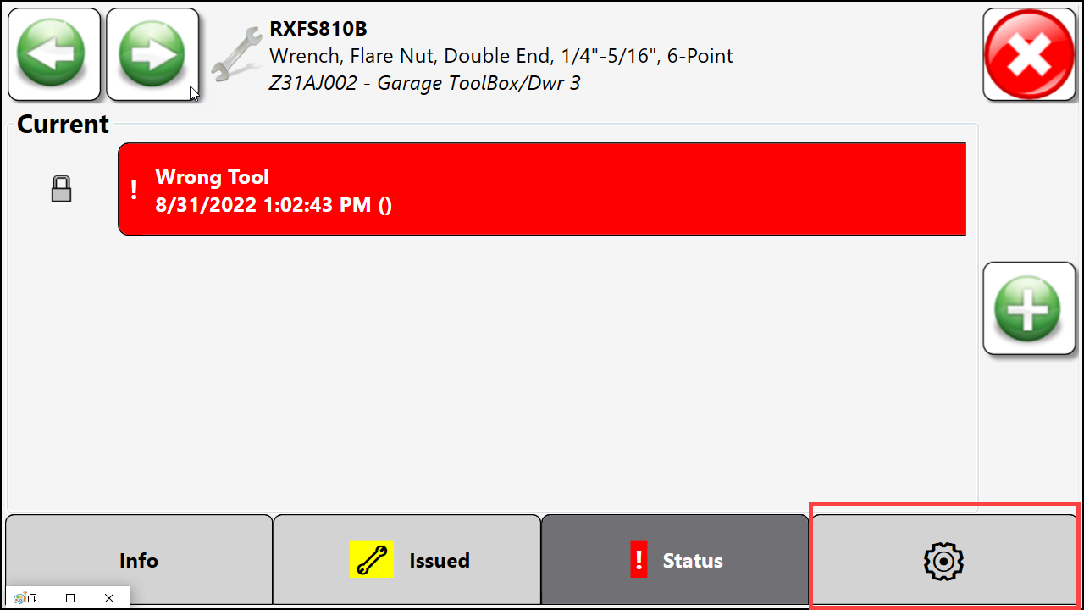



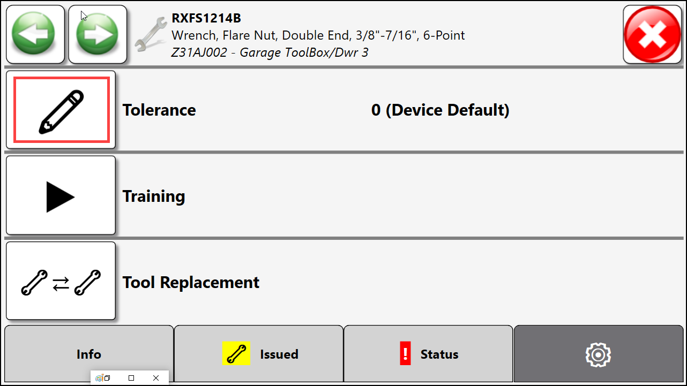
ATC Toolbox – Alerts - Wrong Tool Error
Wrong Tool error – Persistent Error – correction options
If tool is correctly located in the foam pocket and there are no visible changes. Try correcting problem by performing the following:
  Alter Tolerance – lower sensitivity
    Certain tools may require relaxed tolerance to prevent false positive wrong tool errors, ie. meter cords, electrical cords, or tools that have multiple shapes
    On Tool Error page - Select Settings Tab
    On tool Settings Page – Select Tolerance icon then
    Move slider bar to less sensitive, default value is 0 set to least sensitive at 10.
    After change Select confirm icon –
    Verify if tool has changed in behavior and error clears
60

Slide 61

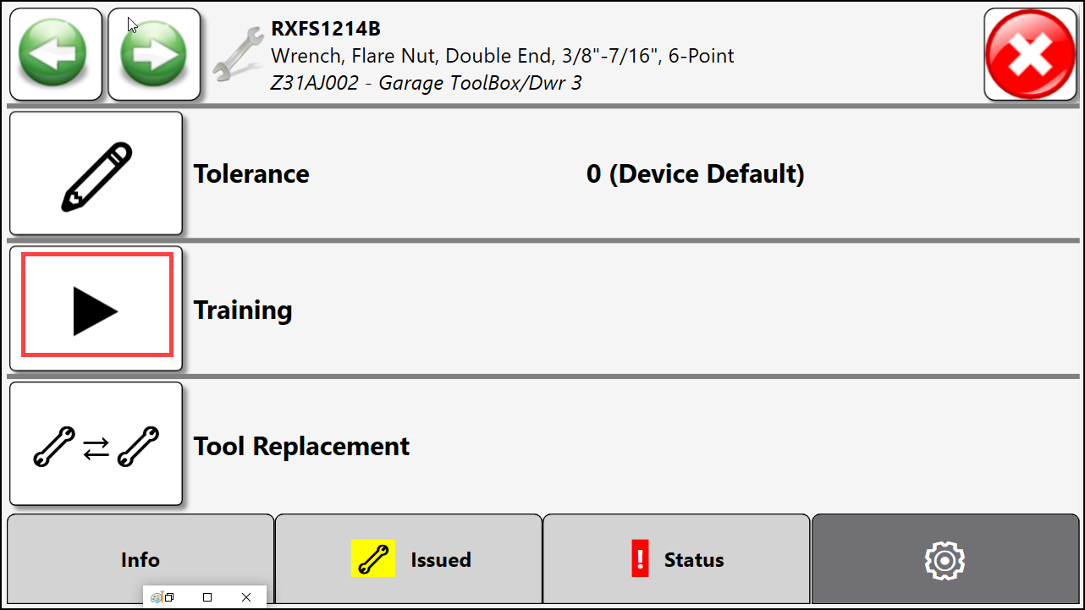

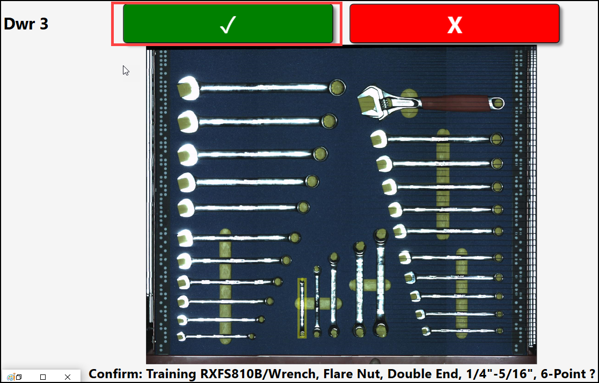
ATC Toolbox – Alerts - Wrong Tool Error
Wrong Tool error – persistent error – correction options
If tool is correctly located in the foam pocket and there are no visible changes. Try correcting problem by performing the following:
  Retrain Individual Tool
    Retraining an individual tool can help if subtle changes have occurred to a tool and the imagery has changed. Process is similar to a present signature drawer training. On Tool Error page - Select Settings Tab
    On tool Settings Page – Select Training icon
    Training verify screen will pop up – Select Yes
    Follow the verbal training instructions.
      Tool will need to be removed, replaced and, if necessary, adjusted within the pocket.
    Verify if tool has changed in behavior and error cleared.
61

Slide 62
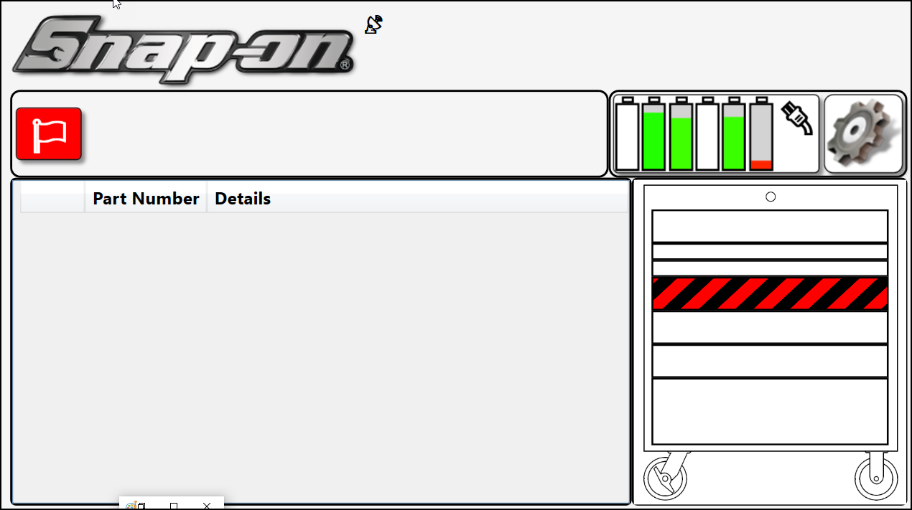

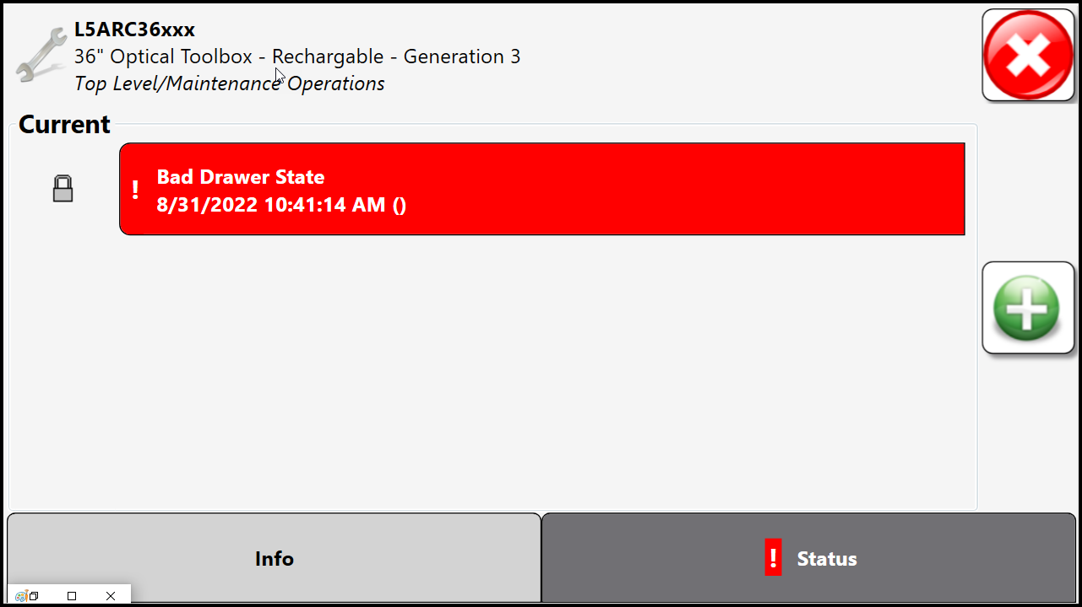
ATC Toolbox – Alerts – Bad Drawer Scan
Bad Drawer Scan
A bad drawer scan will result in a black and red alert on the respective drawer and will generate an alert
  To clear a bad drawer scan
    A complete scan is required to clear a bad drawer scan. Make sure the drawer slides are fully extended; sometimes they can bind a few inches short of full travel.
    Check the Dot strips in the problem drawer. Make sure they are not obstructed and are free from dirt, debris, grease, and damage. Make sure they are both oriented in the correct direction.
    Check the mirror for grease or fingerprints, especially in the area above the dot strips.
    Check the upper arear of the toolbox, ensure there is nothing blocking the camera views.
    Check if the “Require full drawer scan” option has been enabled at the admin. This option will generate incomplete drawer scans if the full drawer is not seen during every open.
    Check audit images for clues to problem areas in the drawer. Areas that did not properly stitch are likely areas to check for problems. Remember that you must log out at the box before audit images are sent to the admin.
62

Slide 63





ATC Toolbox – Service Disconnect
Service Connection
  A properly connected ATC will display a in the upper middle of the main display.
  The Administration software also will show the ATC being online
  An ATC is fully functional when it is offline. All current users assigned access to the ATC devices will still have access.
Service Connection Problems
  A Service connection error will present itself as an Alert on the main screen
  Selecting the Alert flag will verify its offline
  Selecting the Diagnostic icon can help correct the problem or provide information to help fix the problem.
63

Slide 64
ATC Toolbox – Service Disconnect
Service Connection - Troubleshooting
A service disconnect can occur for multiple reasons.
  Network Error – ATC device or devices can not connect to Service computer
    On ATC verify physical layer of wired/wireless network connection
      If wireless, verify system is connected to router.
      If wired, verify Ethernet cable plugged into ATC as well as switch.
    On Service computer verify physical layer of wired/wireless network connection
      If wireless, verify Wifi connection is up and connected to correct SSID (router)
      If wired, verify Ethernet cable plugged into computer as well as upstream switch.
  Time Mismatch – Diagnostics will report the time mismatched
      If the server time and the ATC time are more than 5 minutes apart an Alert is generated that the device can not talk to the service.
      Adjust time on ATC device
  Service Computer
    TrueSite Service has stopped
    Windows updates changed a setup in the firewall or service connection
64

Slide 65




ATC Toolbox – Service Disconnect
Reset Service on ATC
  Run Diagnostics when ATC Unit is offline
    Select Alert Flag
    Log in as Admin or Superuser to display Diagnostic Icon
    Select Diagnostic Icon
  Output of Diagnostics Test - Passed
    If ATC test corrects the link and runs clean the output will appear as below. Green checks show each test passed.
    If the test passes back out of open pages back to main screen.
  Output of Diagnostics Test - failed
    If the ATC test fails and does not run clean the output will appear as below.
65

Slide 66


ATC Toolbox – Service Disconnect
Service Connection - Troubleshooting
  Verify ATC Service is running on Service computer
    From Windows Search Type – Services
    Select Run as Administrator
    Find and highlight Tool Control System Service
    Start service if stopped
  Incorporate networking logic into the troubleshooting
    If there are other ATCs on the network verify they are working and online, if so, the problem is likely within the one ATC.
    If all ATCs on the network are offline more than likely the issue is an upstream network item or the service computer.
  On ATC verify wireless adapter is connected
    Select Touch for Menu and drill to second page.
    Select Network Setting
    Verify connection is up and connected to correct SSID.
  If wired verify Ethernet is listed and connected
66

Slide 67
Lab 10 – Using the Toolbox

Slide 68
L5 Connect
Calibration and Drawer Training

Slide 69
What is Calibration and what does it do?
Calibration tells the cameras how to stitch together the drawer images.
You do not need to calibrate a ATC Toolbox unless you are getting bad images from the stitching.
Always COLLECT and INSPECT all drawer archive images for errors BEFORE proceeding to drawer training.

Slide 70
You should only calibrate when…
You have replaced or adjusted an imaging part
  ATC Chassis
  Camera
  Mirror
  Drawer Foam
  Dot Strips
  Drawer location
There are archive image errors
  Lines in image (a.k.a. Window Blinds)
  Missing sections of drawer
Unexplained “Bad Drawer Scans” or failure to detect open drawer

Slide 71

IMAGE ERROR - Lines in Image (a.k.a Window Blinds)
Caused by not pulling on upper drawers before Vertical Alignment (white strip)
Must perform Full Calibration to repair

Slide 72


IMAGE ERROR - Missing Section of Drawer
Restart calibration at Horizontal Alignment to repair

Slide 73

NORMAL – Distortion of Tall Tools
THIS IS OKAY!!!
Do NOT recalibrate if tall tools look distorted. This is parallax and cannot be corrected.

Slide 74

NORMAL - Missing Small Section at Front of Drawer in Open Image
THIS IS OKAY!!!
Do NOT recalibrate if there is a small portion missing from the drawer front in the open image.

Slide 75

Missing Large Section at Front of Drawer in Open Image
Do NOT recalibrate to correct this error.
Instead adjust the default exposure

Slide 76
To avoid wasting time…
REMEMBER!!!
COLLECT and INSPECT all drawer archive images for errors BEFORE proceeding to drawer training.

Slide 77
Toolbox Drawer Training
Drawer training performs these important tasks:
  Import tool information into the toolbox database from the water jet “foam file”.
  Align the foam file tool silhouette information against the actual drawer image.
  Assign the tool silhouettes to a responsible camera, breaking them into separate pieces if necessary.
  Store a reference absent signature for future tool detection.
  Store three reference present signatures for future tool detection.
  Capture an archive image of the drawer used to indicate the position of tools to the user – “wrong tool” image.

Slide 78
Foam File Information
Foam Files are text files.
  Drawer01.txt
  1 per drawer
Contain information used by the ATC system.
Object Type (Silhouette, Notch, Channel, Pallet, Hole)
Tool ID Number
Part Number, Part Description
Foam Location
Foam Silhouette
Excerpt from Drawer02.txt
…
Silhouette SDM222ZB
TOOL_BOX_ID 100
DRAWER DRAWER-2
POSITION S-0
DESCRIPTION Bit, PHILLIPSr, #2
ULC 656 2085
LRC 680 2112
1 12 1
1 10 5
1 8 9
1 6 13
…

Slide 79
Loading New Foam Files
Use the Admin Client to load new foam files.
Software tries to maintain links between old & new tools.
Manually loading foam files to the tool box can result in database corruption.
  Tool ID numbers may or may not match previous entries in the database.

Slide 80
Aligning Foam File to Drawer Image
Software prompts user to open drawer, remove tools, close drawer.
Certain tools should always be removed.
  Tall tools (parallax)
  Blue tools (not enough contrast with surrounding foam)
  Tools that overhang their silhouette
Objects not defined in the foam file can confuse the software.
  Labels, undefined channels, etc.
Remove pallet contents, NOT pallets.

Slide 81
Foam File Alignment
Correct for minor deviations introduced in foam cutting process.
Check for foam file errors.
Check for inconsistency between drawer image and foam file.
  Foam plugs not removed
  Silhouette mismatch
  Floating finger notches
  Multi-level silhouette cut mismatches
  Foam rotated 180 degrees when glued to backing
Software tries to correct for layout rules violations.
  Expand super thin sections
  Trim back line violations
Persist previous tool information.

Slide 82

Alignment Error Feedback
Identifies the silhouette group or foam file line that failed.
User can set fade between foam file silhouette and image to check for mismatches.
Zoom in and out.

Slide 83


Full Drawer Scan Required
Software requires complete drawer scan.
Drawer slides can stick, be sure to tug.
Insufficient view of back of drawer can cause errors.

Slide 84

Understand Tool Detection
How the system classifies special colors.
  Yellow gets extra weight when calculating scores.
  Shiny tools, especially chrome, have highly changing appearance based on lighting conditions.
  The system lumps gray, black, and white colors into the chrome score to compensate.

Slide 85


Understand Tool Detection
Absent and present scores are compared to determine the best match
  If the absent and present signatures are too similar, the tool cannot be reliably detected!
Larger tools will be split into multiple sections for tool detection
  Only sections seen by the cameras will be scored.
  Any section that does not match will cause a wrong tool.

Slide 86

Tools To Watch Out For
Yellow Tools
  Software cannot tell the difference between subtle shades of yellow.
  May have to wrap or paint section of tool.

Slide 87


Tools To Watch Out For
Tools with holes that change based on orientation in the foam pocket.
  Changes the amount of yellow = IMPORTANT (Example: universal joints)
    Think from the “camera point of view”.
  Rotational invariant = NOT IMPORTANT (Looking down at a socket).
    The amount of yellow does not change.

Slide 88

Tools To Watch Out For
Shiny colors
  Appears white (chrome) when perfectly flat.
  Changes to red color when propped up (handle laid down).

Slide 89

Tools To Watch Out For
Rotated color/foam coverage differences.
  Tool naturally sits in more than one position, exposes different color mix.
  Flathead screwdriver foam coverage changes based on rotation.

Slide 90

Tools To Watch Out For
Adjustable tools
  Adjustment reveals different foam coverage.

Slide 91

Tools To Watch Out For
Cords & flexible tools
  Can change significantly every time they are returned.
  Often require tolerance adjustment for correct detection.
  Think about changing the yellow percentage during present acquisition.

Slide 92

Tools To Watch Out For
Pallets
  Leave pallet in during absent training stage.
  After training, remove pallet(s) to record their absent signature.
  Pallets require special identifying info in foam file.
  Pallets are not interchangeable – key layouts to prevent confusion.
  Finger notches are used to locate pallets during alignment process.
  Removing pallet auto issues all child tools.

Slide 93
Tools To Watch Out For
Extremely small foam cross section.
  Hex bits, Allen wrenches, needle files, etc.
  Foam glue often leaks into yellow.
  Deep foam can hide the yellow backing.
  Usually need to add plug inserts for best results.

Slide 94
Drawer Training Options
High Accuracy (Recommended!)
  Best Results
  Tool alignment, absent signature, 3 present signatures
No Tool Removal
  High Accuracy with NO absent signature
  Algorithm will guess absent signature, store when close enough
  Only have to remove tools that cause alignment problems
Present Signatures Only
  No silhouette alignment
  3 present signatures, updates “wrong tool” image
Absent Signatures Only
  Absent signatures only (remove ALL tools)

Slide 95
Drawer Training Tips
Pay attention to the current step in the process.
  Don’t accidentally put all of the tools in the drawer when creating the “Absent Image”.
Gather all the tools that belong in the box, before you start.
Missing one or two tools?
  Cover or fill the pocket during present signature training, then perform individual tool training when they are available (“wrong tool” image will still be inaccurate)
If training does not correct tool detection, look for problems in the archive images.

Slide 96
Tool Detection / Training Issues – Before You Call Support…
Review the audit images from the drawer(s) with issue(s).
  Look for any image distortion or irregularities
If the drawer images have no visible errors perform a High-Accuracy retrain of the drawer.
If the drawer retraining does not clear the issues, collect the following data (for Tech Support):
  Audit images
  Foam files
  List of Tool ID numbers that are having issues
  Device log files that cover the timeframe of the issues
  Screen shots of errors on the display (take a picture with your cell phone).

Slide 97
Drawer Training Issues – Avoid Delays When You Call Support…
Be prepared to send previously collected data to Tech Support:
  Snap-on Equipment Tech Support TECHSUPPE@snapon.com
Tech Support will need to know:
  Toolbox serial number “Z31BJ002” (About screen, grey label on back of ATC top).
  ATC software version “9.3.17.0” (About screen).
  Why are you performing drawer training?
    Symptoms of error, tool or foam change, etc.
  Which drawer training step did you start on (high accuracy, no removal, etc.).
  What else have you already tried?
  Has there been:
    Any recent maintenance on the Toolbox?
    Has there been or strange behavior?

Slide 98
Lab 11 – Calibration and Training

Slide 99
L5 Connect
Hardware Deep Dive

Slide 100
L5 Connect
Q&A

